Slide 1
MSTRG.11892.1

Slide 2
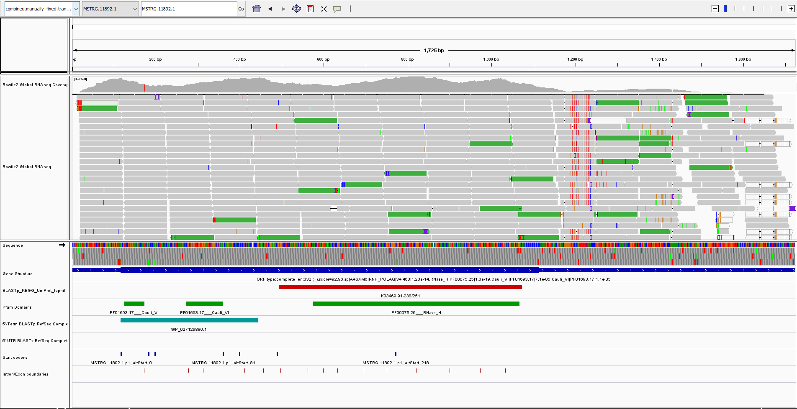

Slide 3
Eukaryotic RNases HI possess either one or two copies of this domain at there N-terminal
So, these results are not surprising
Domain configuration observed in other species
Domain also found in viruses?
What is the origin of the DNaseHI?
Domain configuration expected in Cyanobacteria or Paulinella
MSTRG.11892.1.p1 0 109 MSTRG.11892.1.p1_BLASTX
- Only had seqs after filtering. No tree.
MSTRG.11892.1.p1 126 319 MSTRG.11892.1.p1_KEGGhit
-

Slide 4
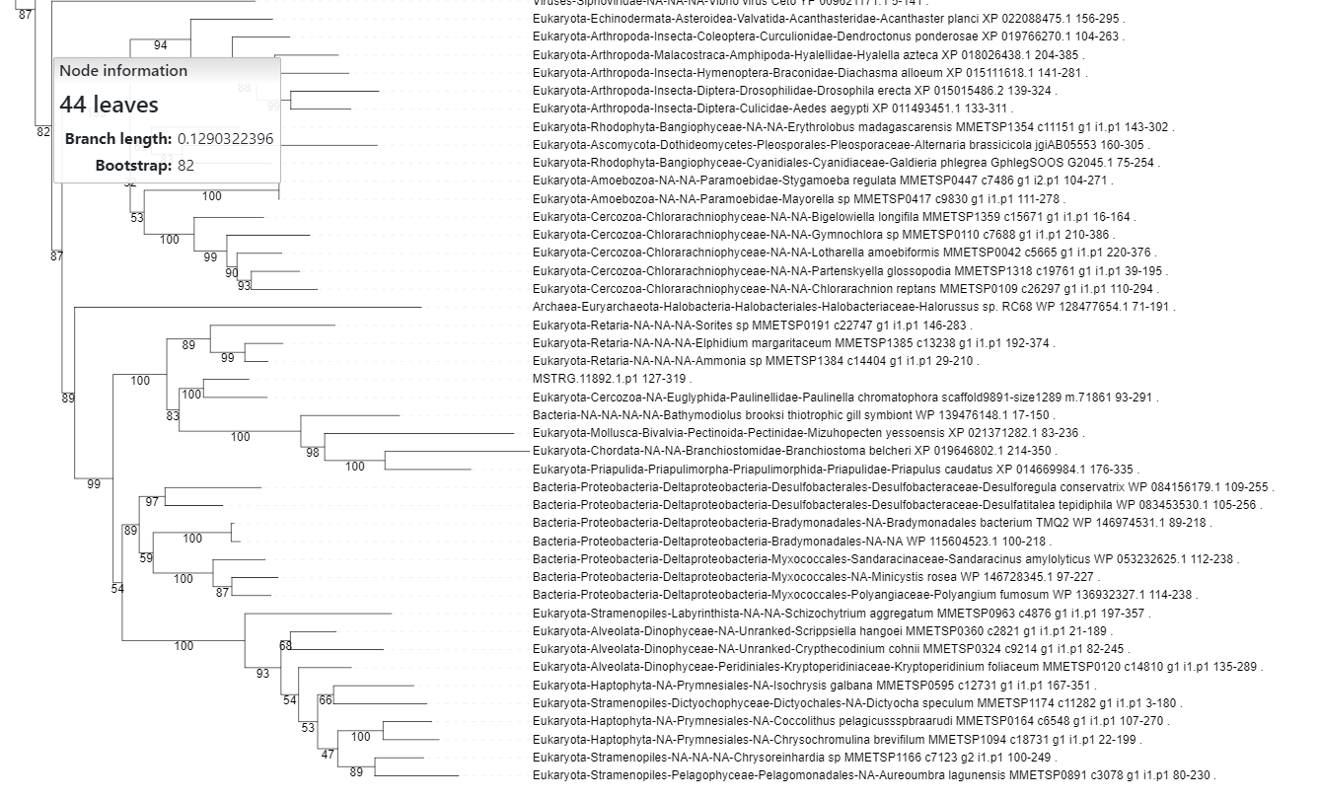
MSTRG.11892.1.p1 0 109 MSTRG.11892.1.p1_BLASTX
- Only had seqs after filtering. No tree.
MSTRG.11892.1.p1 126 319 MSTRG.11892.1.p1_KEGGhit
- Eukaryote (microbial) origin

Slide 5
MSTRG.19480.1

Slide 6
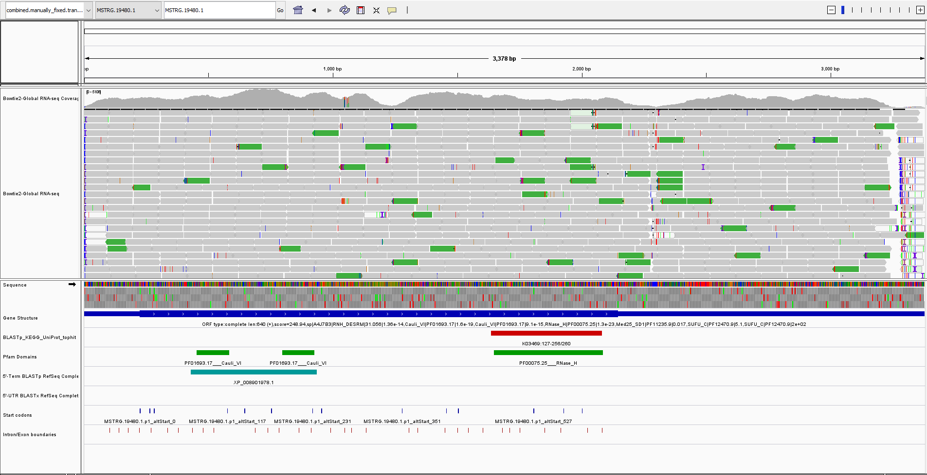

Slide 7
Eukaryotic RNases HI possess either one or two copies of this domain at there N-terminal
Domain also found in viruses?
What is the origin of the DNaseHI?

Slide 8
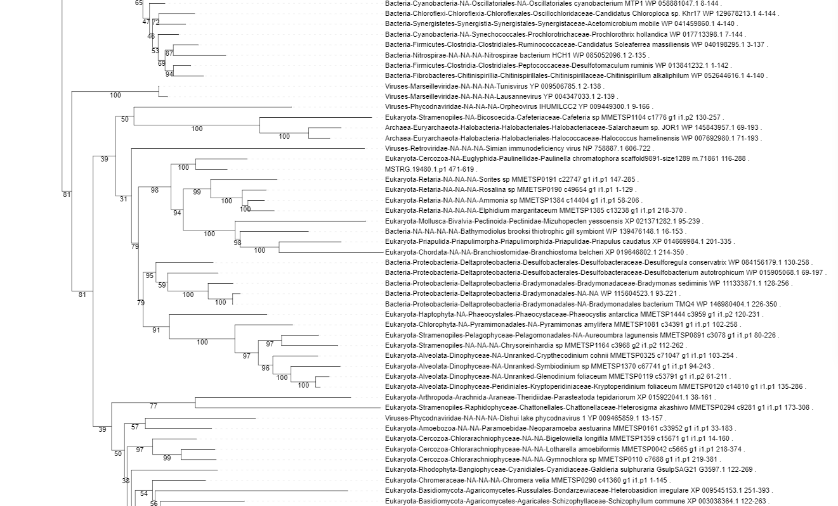
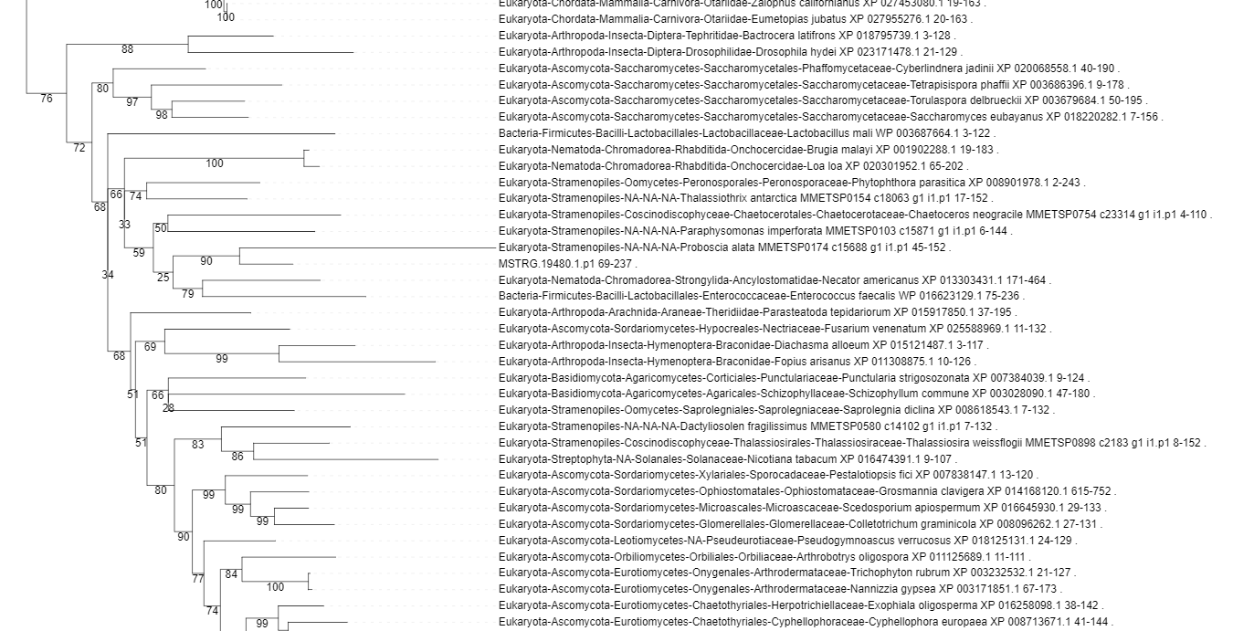
MSTRG.19480.1.p1 68 237 MSTRG.19480.1.p1_BLASTX
- Eukaryotic (microbial) origin. Tree has weak node support.
MSTRG.19480.1.p1 470 619 MSTRG.19480.1.p1_KEGGhit
- Eukaryotic (microbial) origin. Strongly supported clade, with one bacterial sequence (a symbiont species).

Slide 9
MSTRG.27853.2

Slide 10
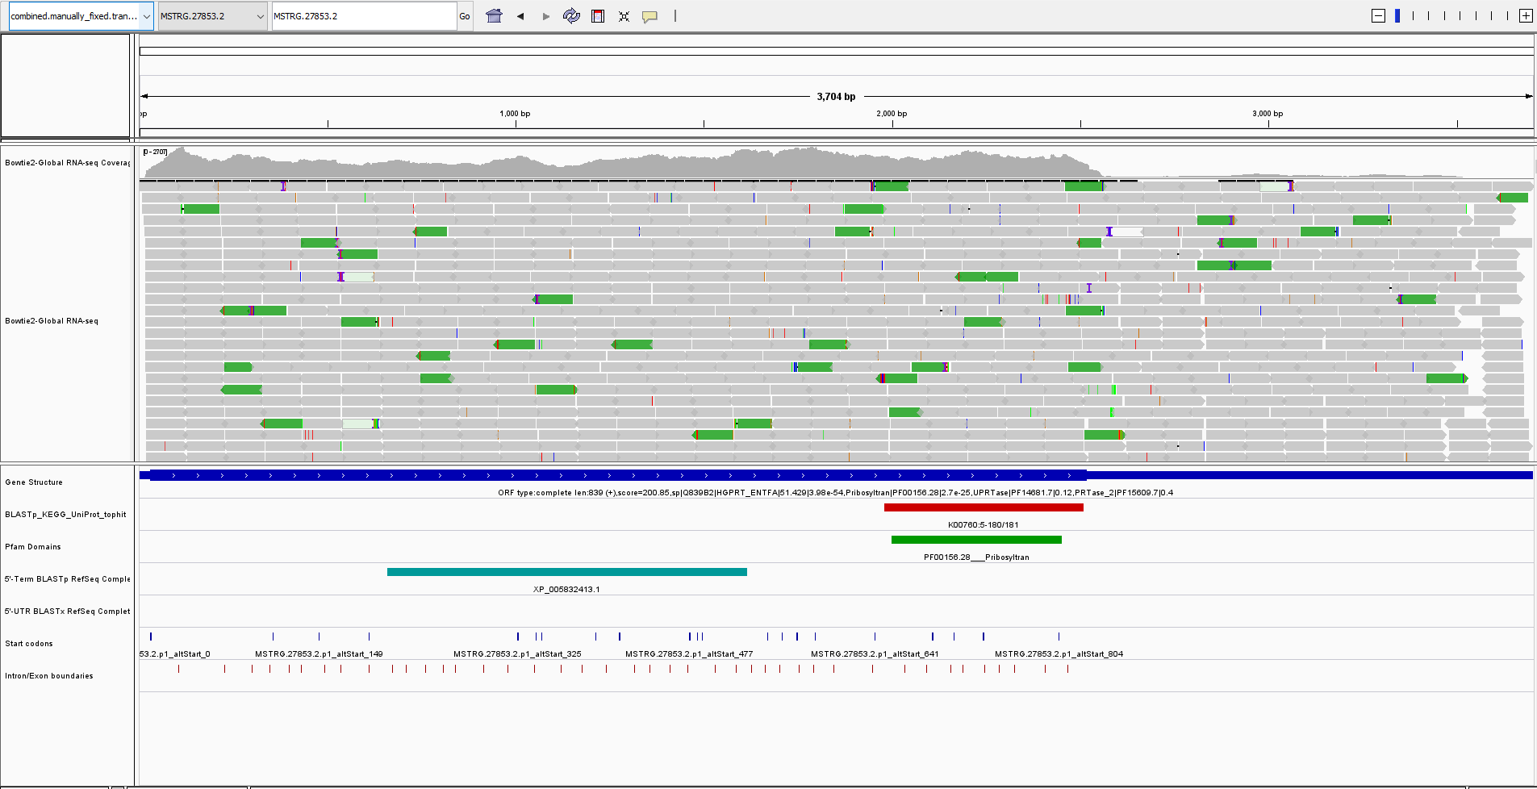

Slide 11
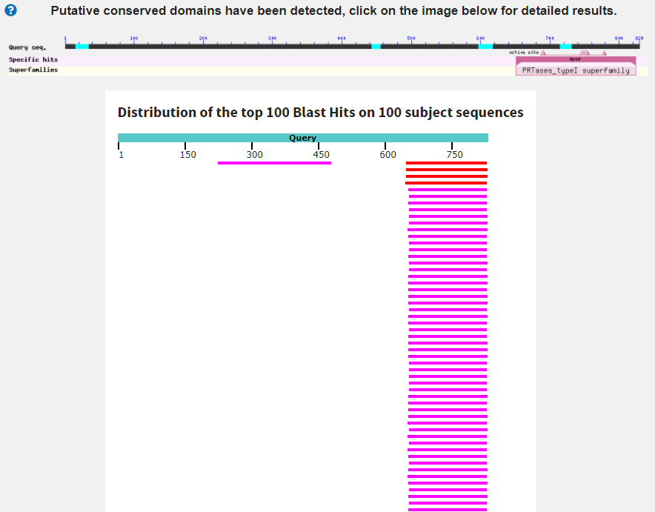
hypothetical protein EON65_55045 [archaeon]
Score:180 Evalue:1.8e-47
Accession:RYG96020.1
archaeon (phyllosphere metagenome)
Is this real? 39% is not particularly convincing.
hypothetical protein PBRA_007144 [Plasmodiophora brassi..
Score:204 Evalue:1.9e-56
Accession:CEO99030.1

Slide 12
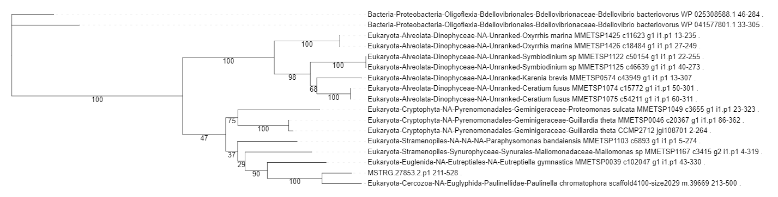
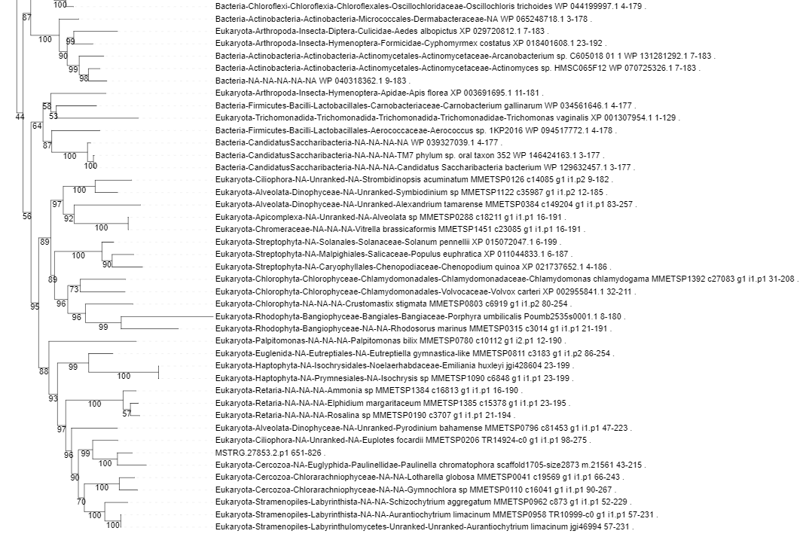
What is the origin of the unknown + KEGG regions?
MSTRG.27853.2.p1 210 528 MSTRG.27853.2.p1_BLASTX
- Clearly eukaryotic origin.
MSTRG.27853.2.p1 650 826 MSTRG.27853.2.p1_KEGGhit
- Clearly eukaryotic origin

Slide 13
MSTRG.21953.1

Slide 14
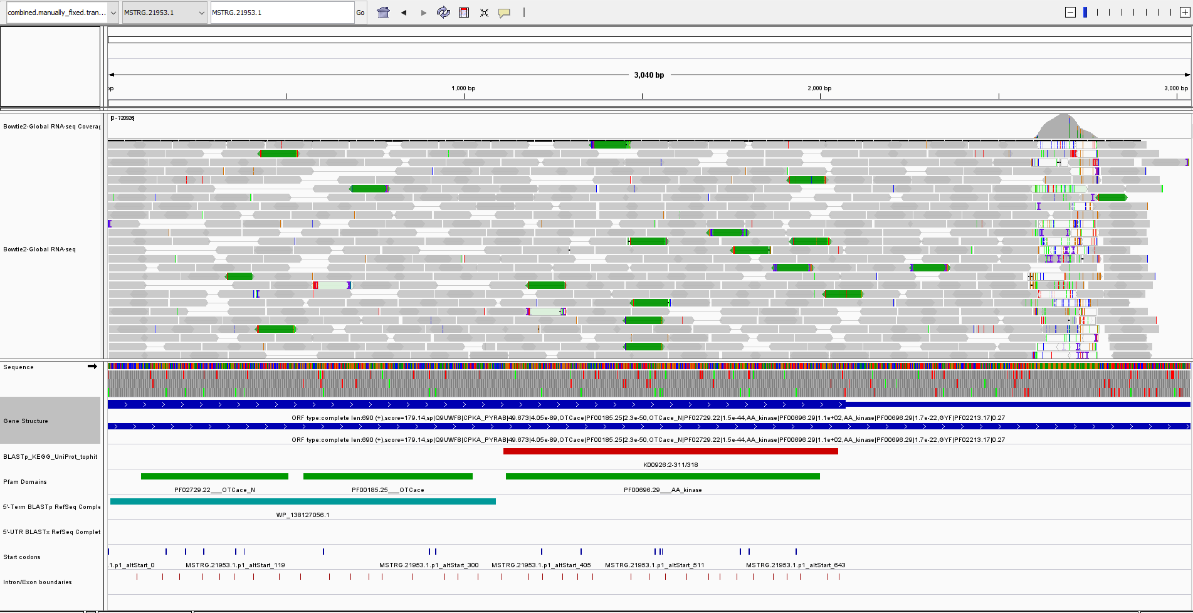

Slide 15
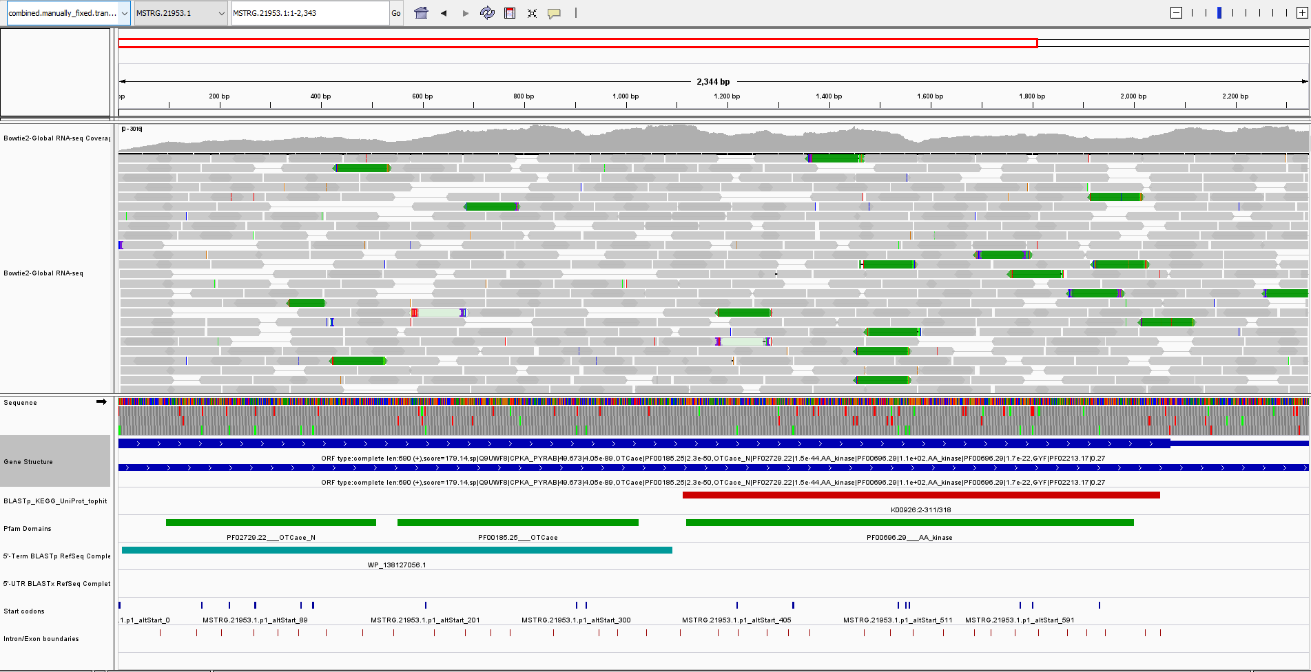

Slide 16
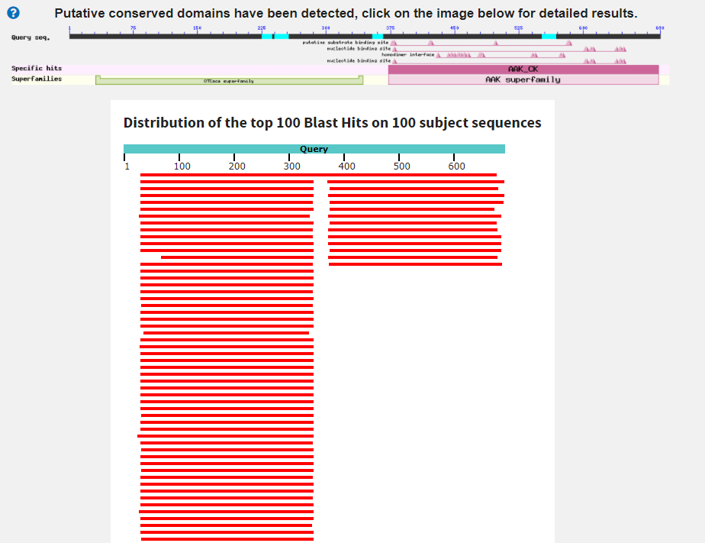
One sequence which covers whole protein:
carbamate kinase [Carpediemonas membranifera]
Score:522 Evalue:1.4e-174 Accession:AMQ24245.1
Eukaryota; Metamonada; Carpediemonas-like organisms; Carpediemonas.
Proteins which align to start of protein:
Ornithine transcarbamylase [Streblomastix strix]
Score:329 Evalue:6.4e-104 Accession:KAA6403939.1
Eukaryota; Metamonada; Preaxostyla; Oxymonadida; Streblomastigidae; Streblomastix.
All appear to be annotated as Ornithine transcarbamylase; a lot of sequences from Archaea
Proteins which align to end of protein:
TPA: carbamate kinase [Synergistales bacterium] Score:273 Evalue:5.3e-82 Accession:HHO11106.1
Bacteria; Synergistetes; Synergistia; Synergistales.
Possibly bacterial origin?

Slide 17
OTCace_N (PF02729) and OTCace (PF00185):
Not found (in PFAM) with AA_kinase (PF00696) in other species
Phylogenetic origin of base/expected domains?
Phylogenetic origin of extra domains?

Slide 18
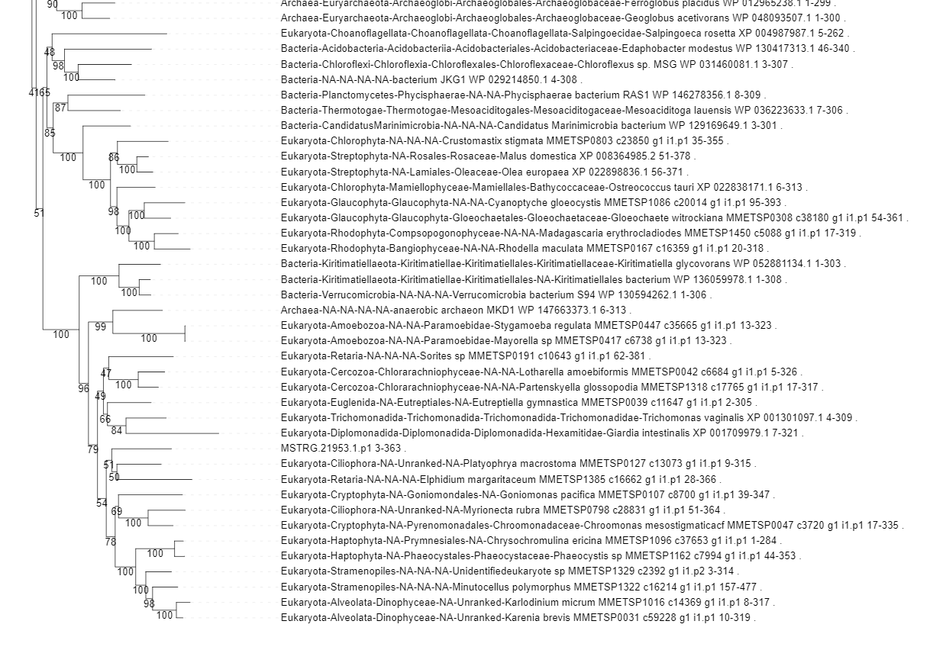
MSTRG.21953.1.p1 2 363 MSTRG.21953.1.p1_BLASTX
- Eukaryotic origin.
MSTRG.21953.1.p1 370 683 MSTRG.21953.1.p1_KEGGhit
- Eukaryotic origin.

Slide 19
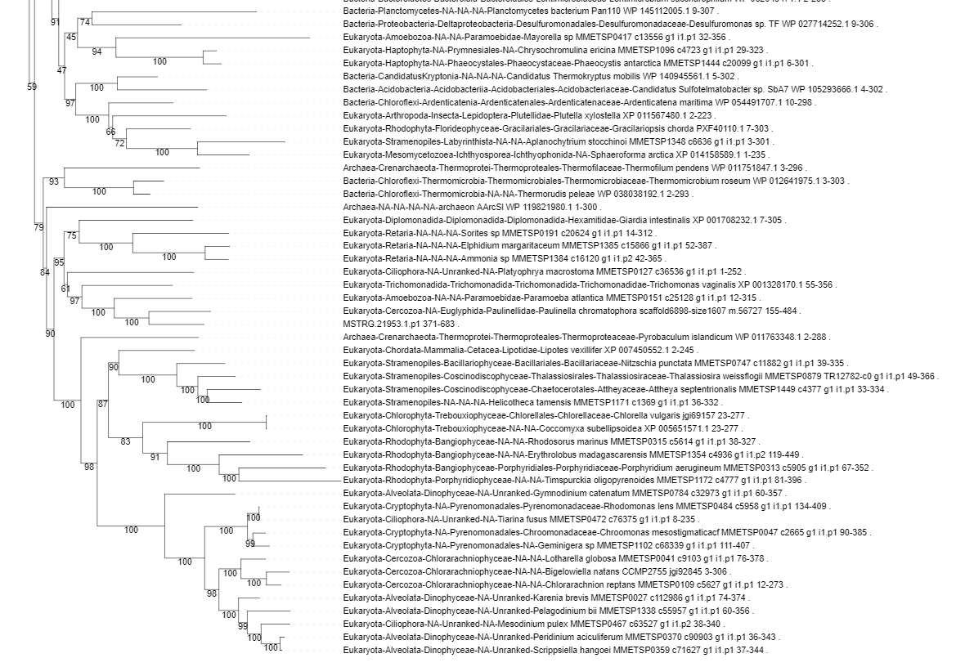
MSTRG.21953.1.p1 2 363 MSTRG.21953.1.p1_BLASTX
- Eukaryotic origin.
MSTRG.21953.1.p1 370 683 MSTRG.21953.1.p1_KEGGhit
- Eukaryotic origin.

Slide 20
MSTRG.8290.1

Slide 21
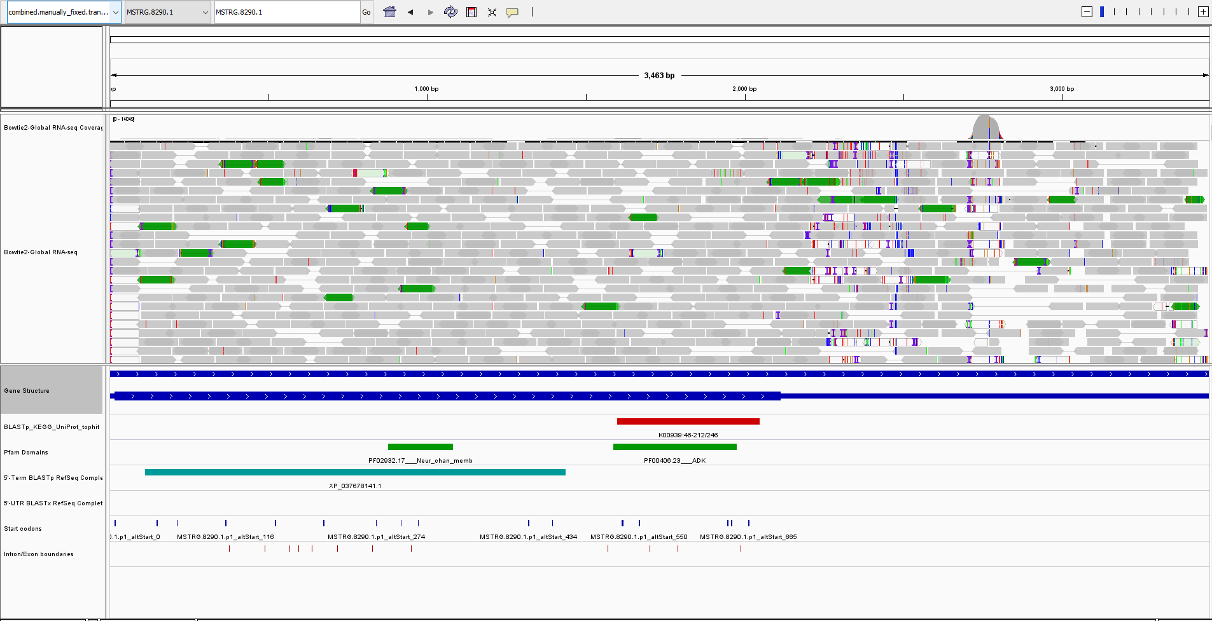

Slide 22
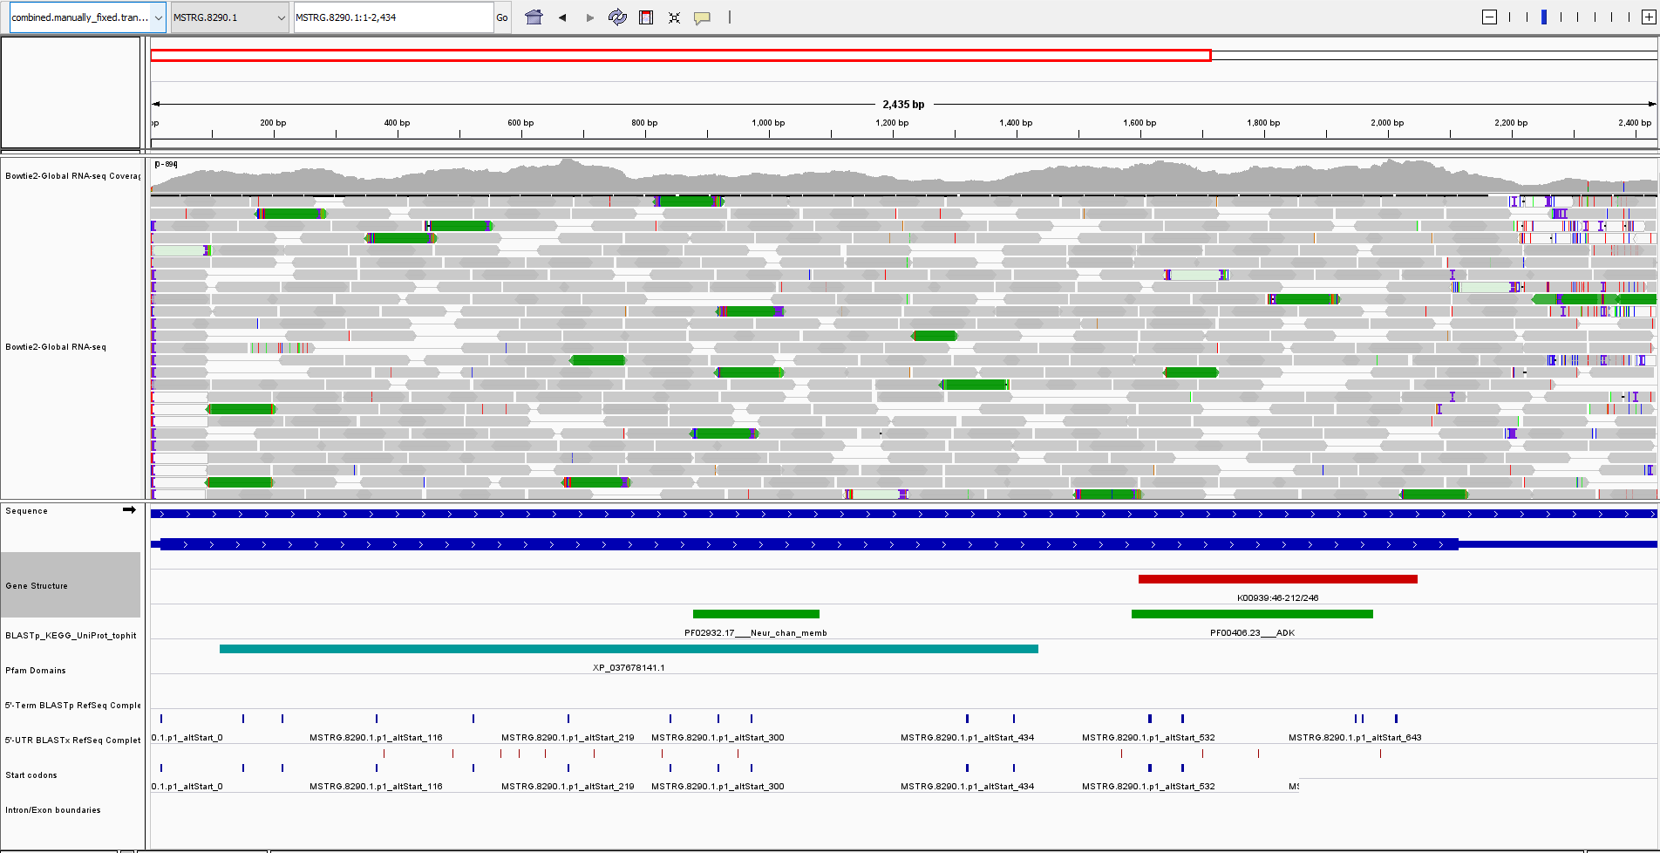

Slide 23
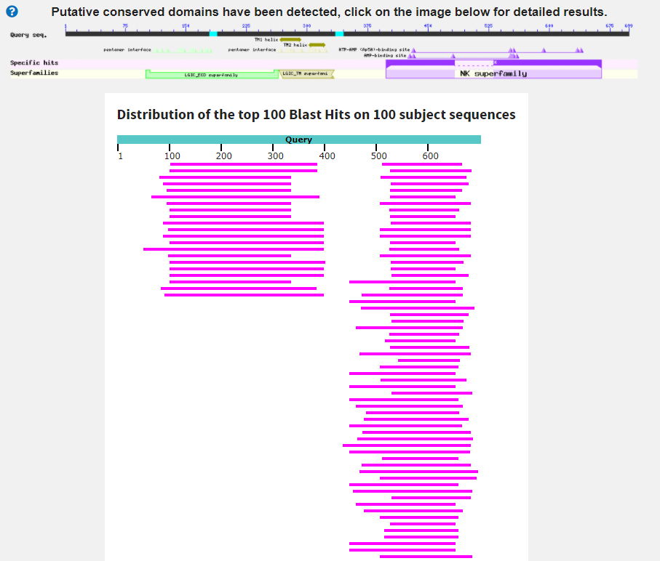
Proteins which align to start of protein:
unnamed protein product [Symbiodinium natans]
Score:107 Evalue:4.7e-21 Accession:CAE7428934.1
Eukaryota; Sar; Alveolata; Dinophyceae; Suessiales; Symbiodiniaceae; Symbiodinium.
Lots of Metazoa proteins. Maybe not from algae but from Metazoa
Mostly unknown/hypothetical proteins. Some ligand-gated ion channels.
Proteins which align to end of protein:
adenylate kinase [Diplonema papillatum]
Score:96 Evalue:1.6e-18 Accession:BAQ25455.1
Eukaryota; Discoba; Euglenozoa; Diplonemea; Diplonemidae; Diplonema.
KEGG annotation is adenylate kinase, so it matches what we expect.

Slide 24
Neur_chan_memb (PF02932):
Not found (in PFAM) with ADK (PF00406) in other species
Represents four transmembrane helices of a variety of neurotransmitter-gated ion-channels
We only have ~67aa out of 238aa total (We probably on have 1 transmembrane helix)
Phylogenetic origin of base/expected domains?
Phylogenetic origin of extra domains?

Slide 25
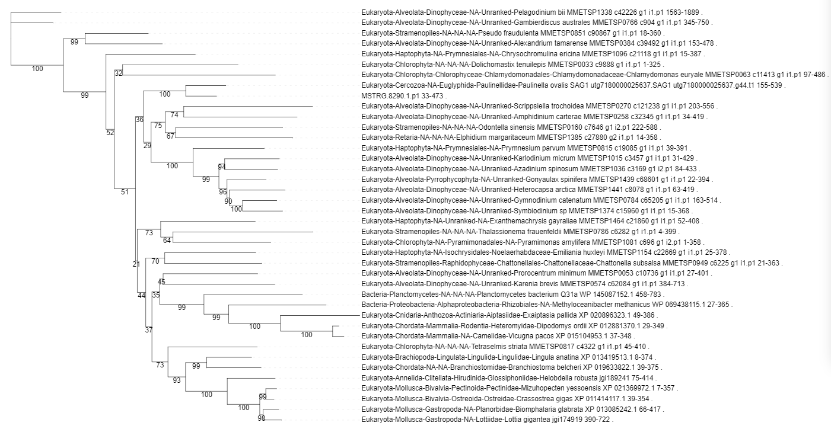
MSTRG.8290.1.p1 32 473 MSTRG.8290.1.p1_BLASTX
- Eukaryotic origin. Week node supports throughout tree but lack of bacterial sequences is enough of a sign that this region is likely eukaryotic.
MSTRG.8290.1.p1 527 677 MSTRG.8290.1.p1_KEGGhit
- Likely eukaryotic origin. Weak node support and long branch, so can’t really say either way so just assume default that it is eukaryotic.

Slide 26
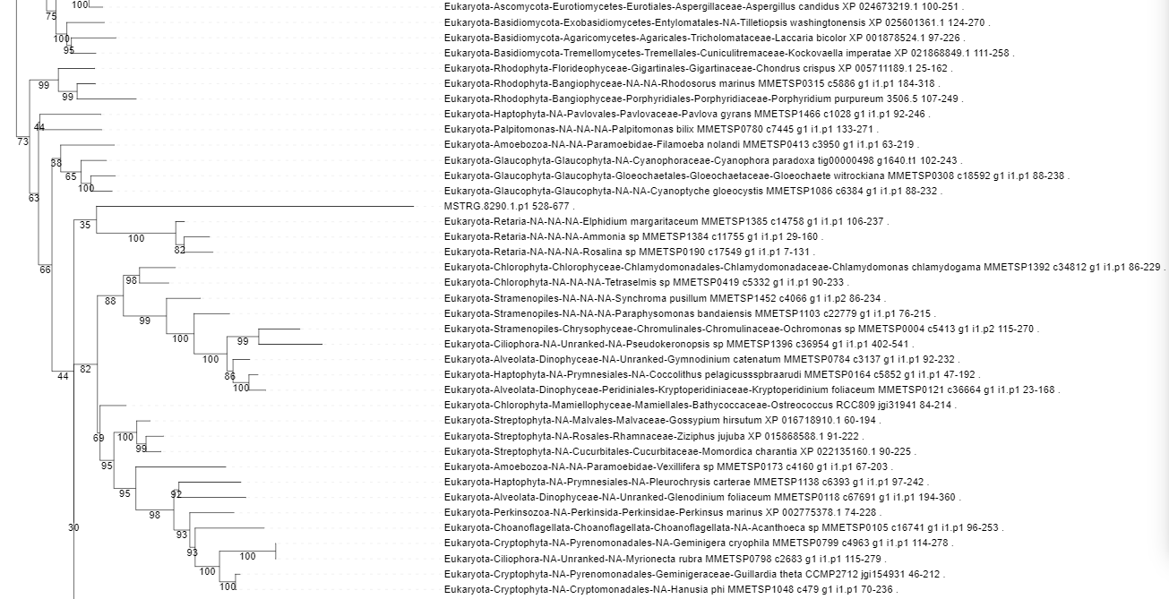
MSTRG.8290.1.p1 32 473 MSTRG.8290.1.p1_BLASTX
- Eukaryotic origin. Week node supports throughout tree but lack of bacterial sequences is enough of a sign that this region is likely eukaryotic.
MSTRG.8290.1.p1 527 677 MSTRG.8290.1.p1_KEGGhit
- Likely eukaryotic origin. Weak node support and long branch, so can’t really say either way so just assume default that it is eukaryotic.

Slide 27
MSTRG.15534.1

Slide 28
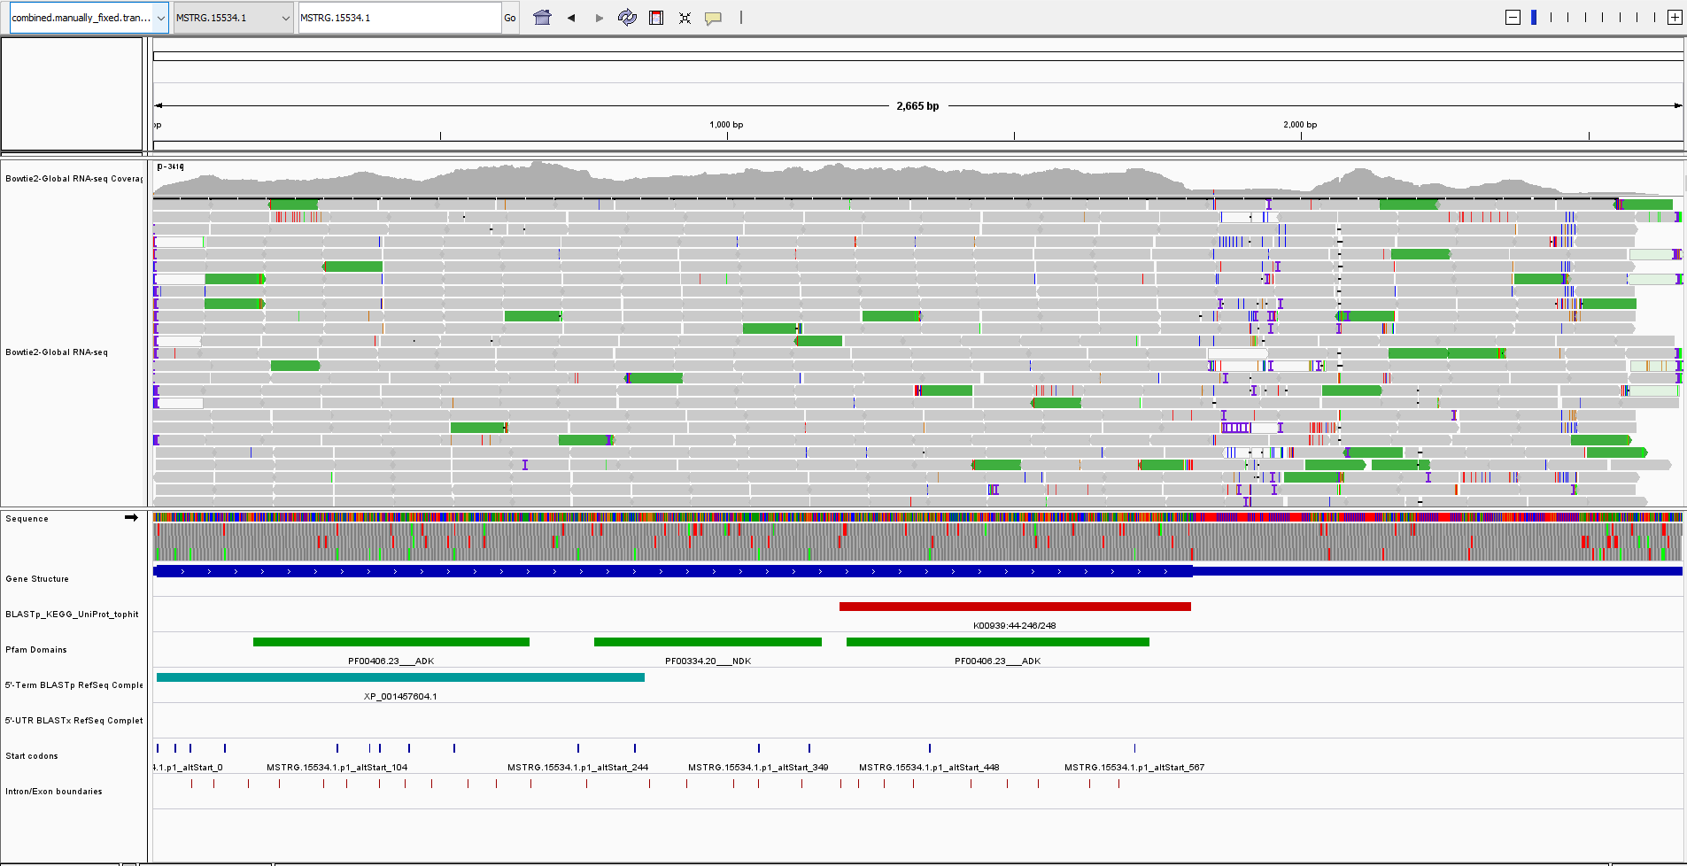

Slide 29
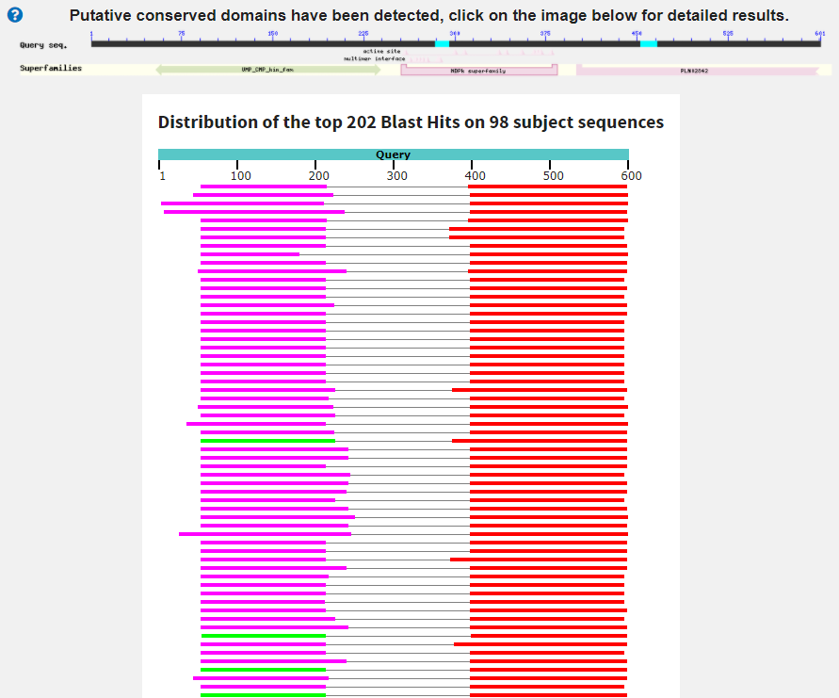
adenylate kinase [Streblomastix strix]
Score:88 Evalue:2e-15
Accession:KAA6365999.1
Two hits to the same subject sequence. First has lower ID% and bitscore then the second.
Both hits cover roughly the same region of subject, meaning that it isn’t a split hit (i.e. subject start and end split by internal exon/s)

Slide 30
NDK (PF00334):
Nucleoside diphosphate kinase
ADK (PF00406)
Adenylate kinase
NDK and ADK are often seen together but not in the ADK-NDK-ADK configuration
Two ADK domains are also often found together but not with a NDK domain
+ a bunch of other configurations found in a single sequence

Slide 31
Phylogenetic origin of base/expected domains?
Phylogenetic origin of extra domains?

Slide 32
MSTRG.15534.1.p1 0 283 MSTRG.15534.1.p1_BLASTX
- Not clear origin. Possibly bacterial? Contains the putative bacterial ADK domain but doesn’t show same pattern, however this region is much larger so that might be why the signal is different and why node support is much weaker.
MSTRG.15534.1.p1 396 600 MSTRG.15534.1.p1_KEGGhit
- Eukaryotic origin. Weak node support but lack of bacterial seqs nearby in tree indicates that it is eukaryotic.
MSTRG.15534.1.p1 56 216 MSTRG.15534.1.p1_ADK
- Maybe bacterial origin.
MSTRG.15534.1.p1 254 386 MSTRG.15534.1.p1_NDK
- Eukaryotic origin.
MSTRG.15534.1.p1 400 576 MSTRG.15534.1.p1_ADK
- Eukaryotic origin.

Slide 33
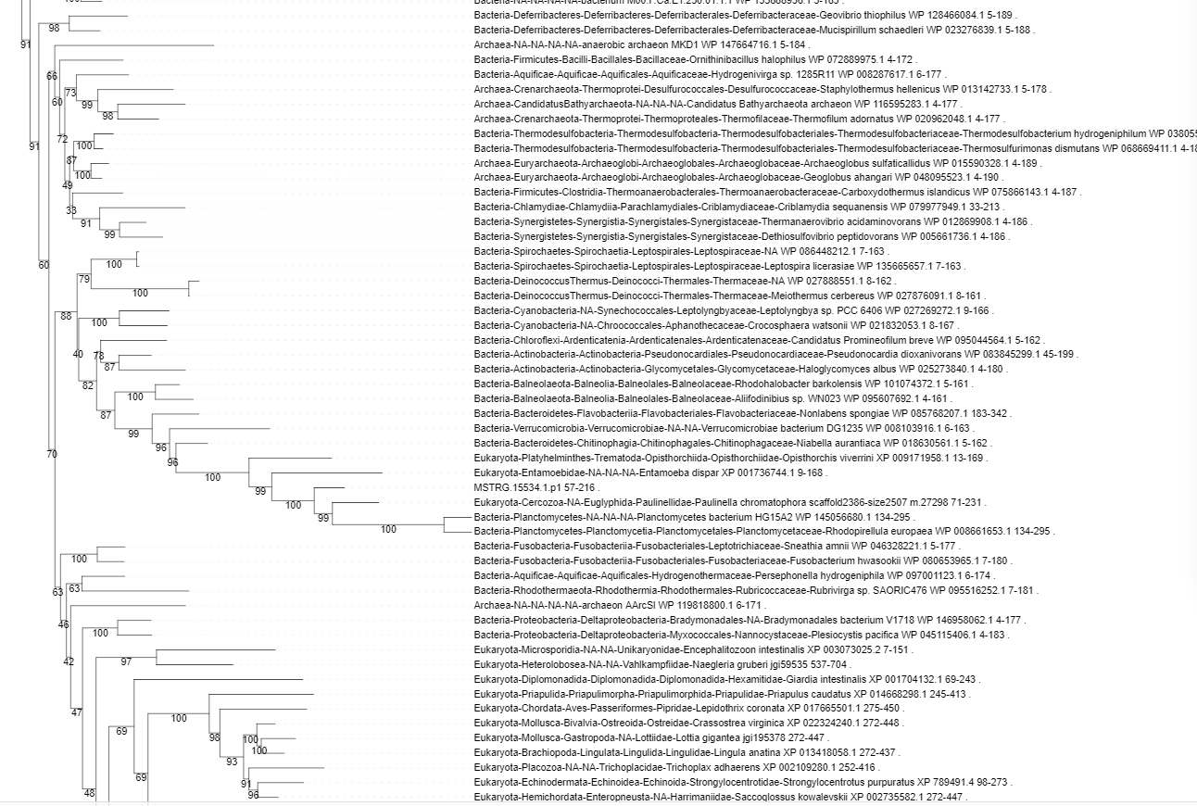

Slide 34
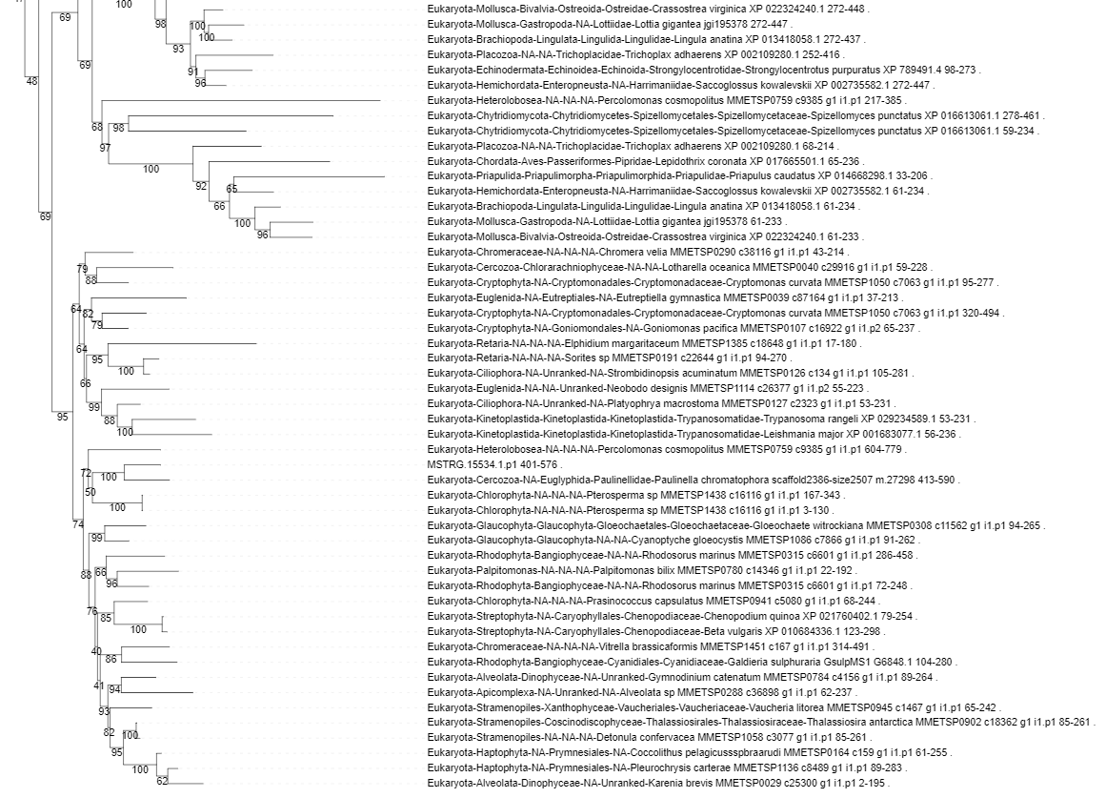

Slide 35
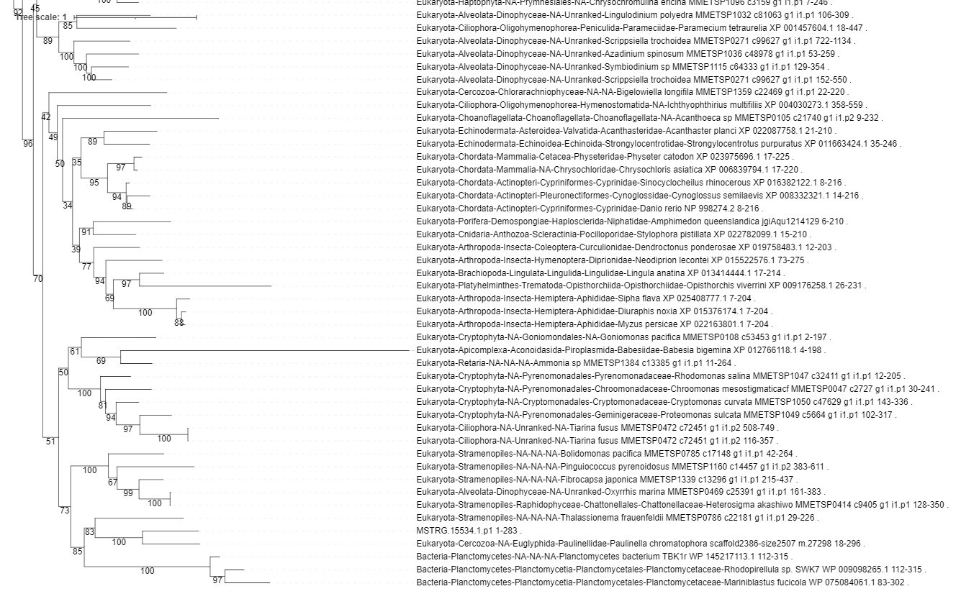

Slide 36
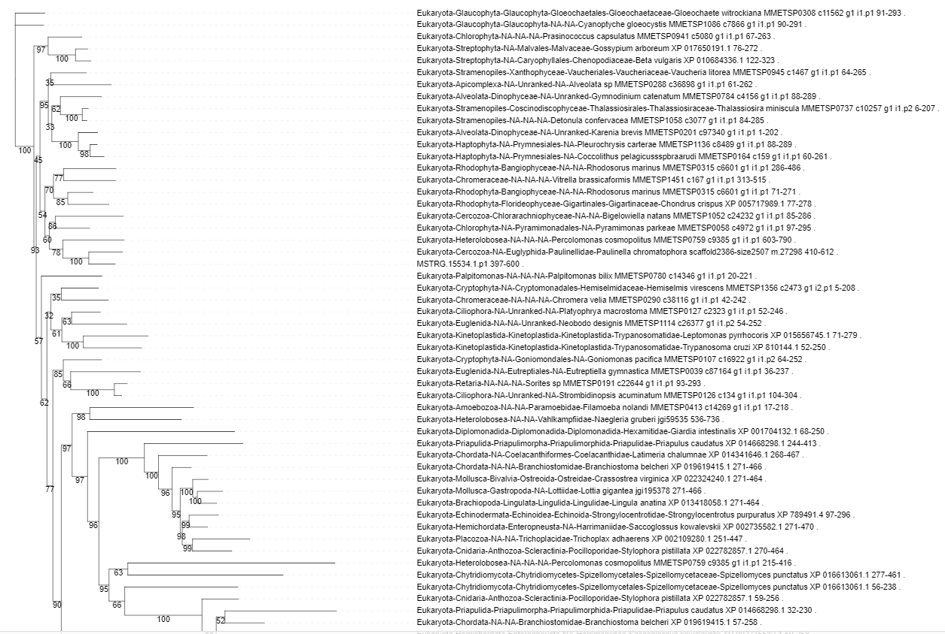

Slide 37
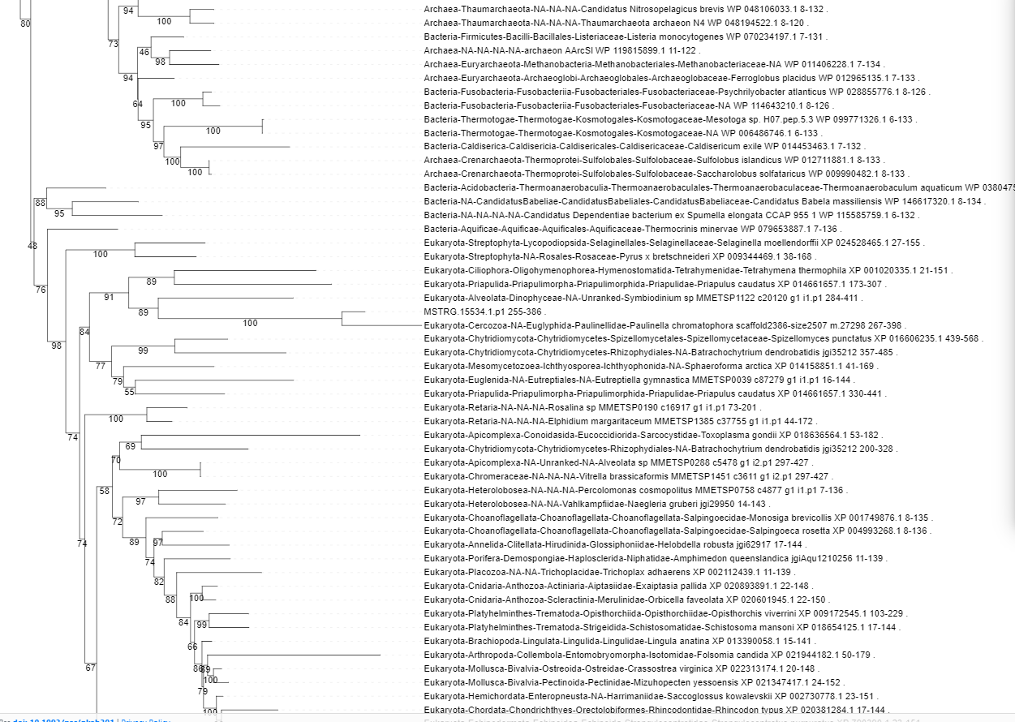

Slide 38
MSTRG.11129.2

Slide 39
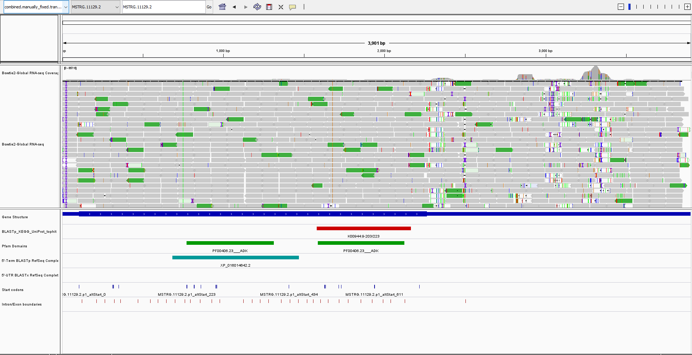

Slide 40
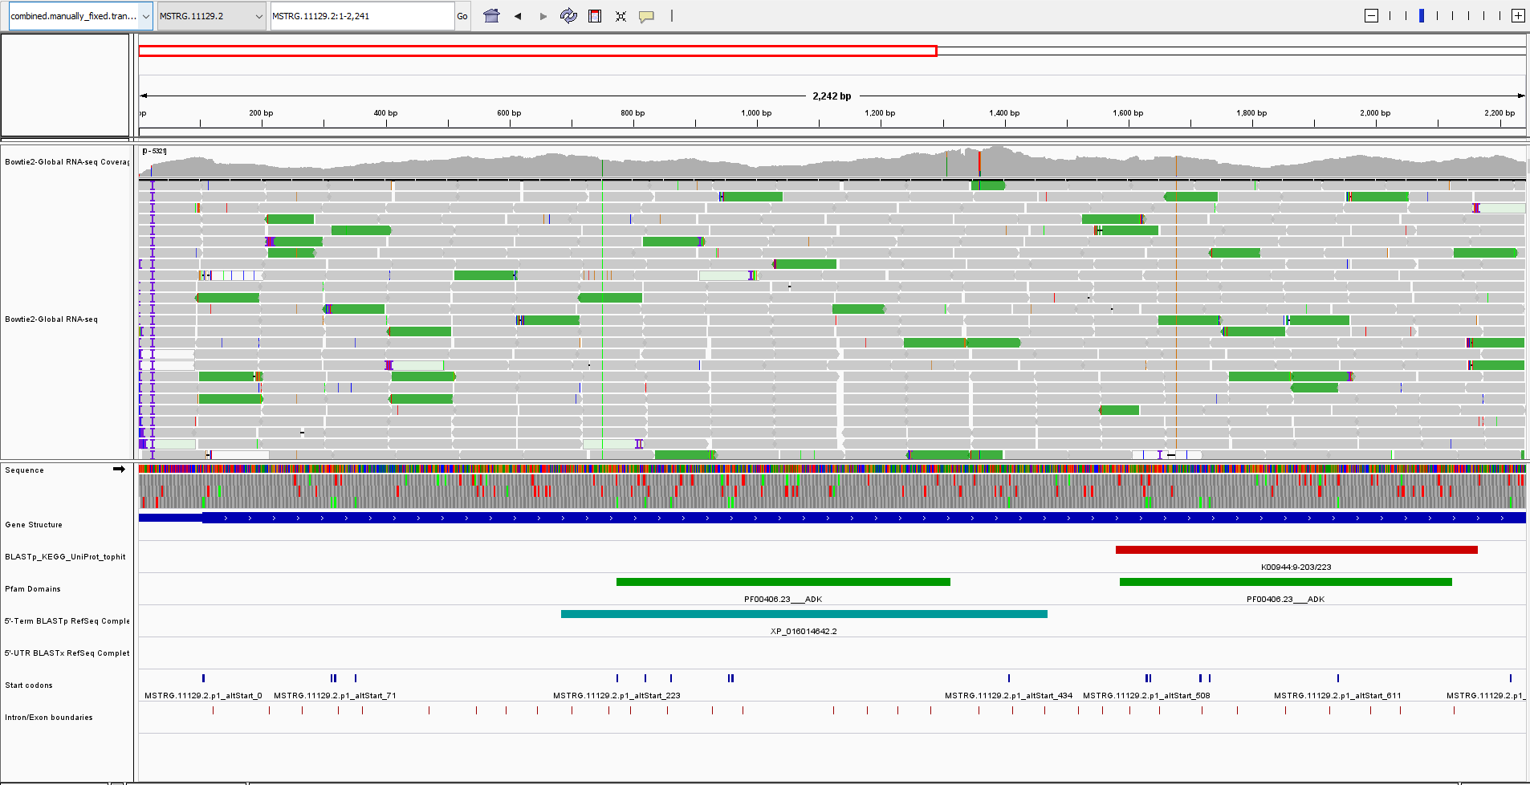

Slide 41
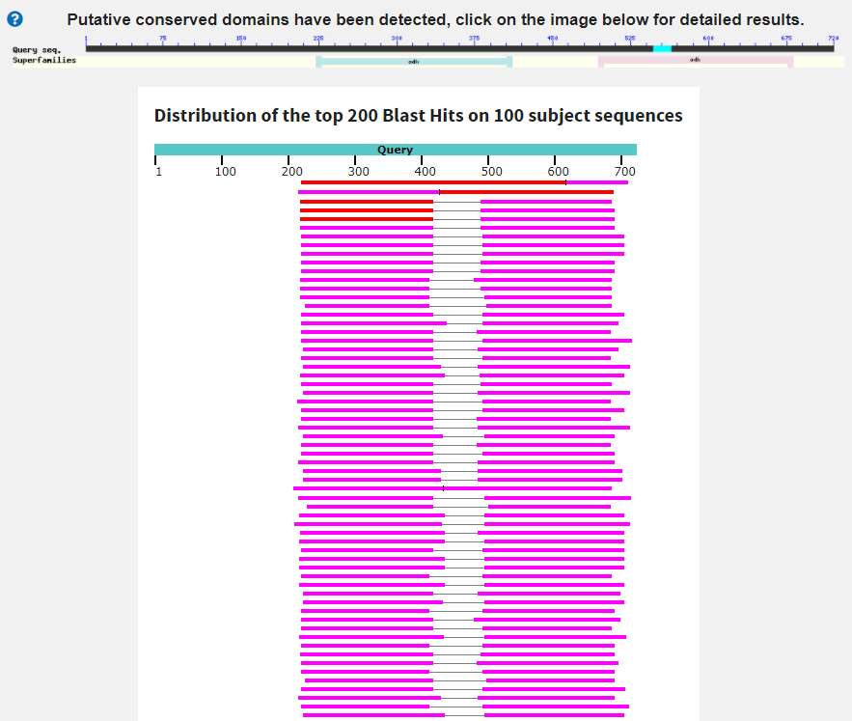
unnamed protein product [Cyprideis torosa]
Score:238 Evalue:1.1e-67
Accession:CAD7234566.1
Subject can align in two different ways over the same region of the query.
Large gaps in the middle of the subject when aligned. Possibly causing the double overlapping hits (i.e. two similar/identical domains close together that are erroneously being joined into a single hit)

Slide 42
ADK (PF00406)
Adenylate kinase
Two ADK domains are also often found together – Not surprising that we also see this I guess

Slide 43
Two of these domains on the same sequence are not surprising (possibly even expected)
Phylogenetic origin of base/expected domains?
Phylogenetic origin of extra domains?

Slide 44
MSTRG.11129.2.p1 193 455 MSTRG.11129.2.p1_BLASTX
- Eukaryotic origin.
MSTRG.11129.2.p1 492 687 MSTRG.11129.2.p1_KEGGhit
- Likely eukaryotic origin. Week node support but majority of taxa in tree are eukaryotic.
MSTRG.11129.2.p1 223 403 MSTRG.11129.2.p1_ADK
- Eukaryotic origin.
MSTRG.11129.2.p1 494 673 MSTRG.11129.2.p1_ADK
- Eukaryotic origin.

Slide 45
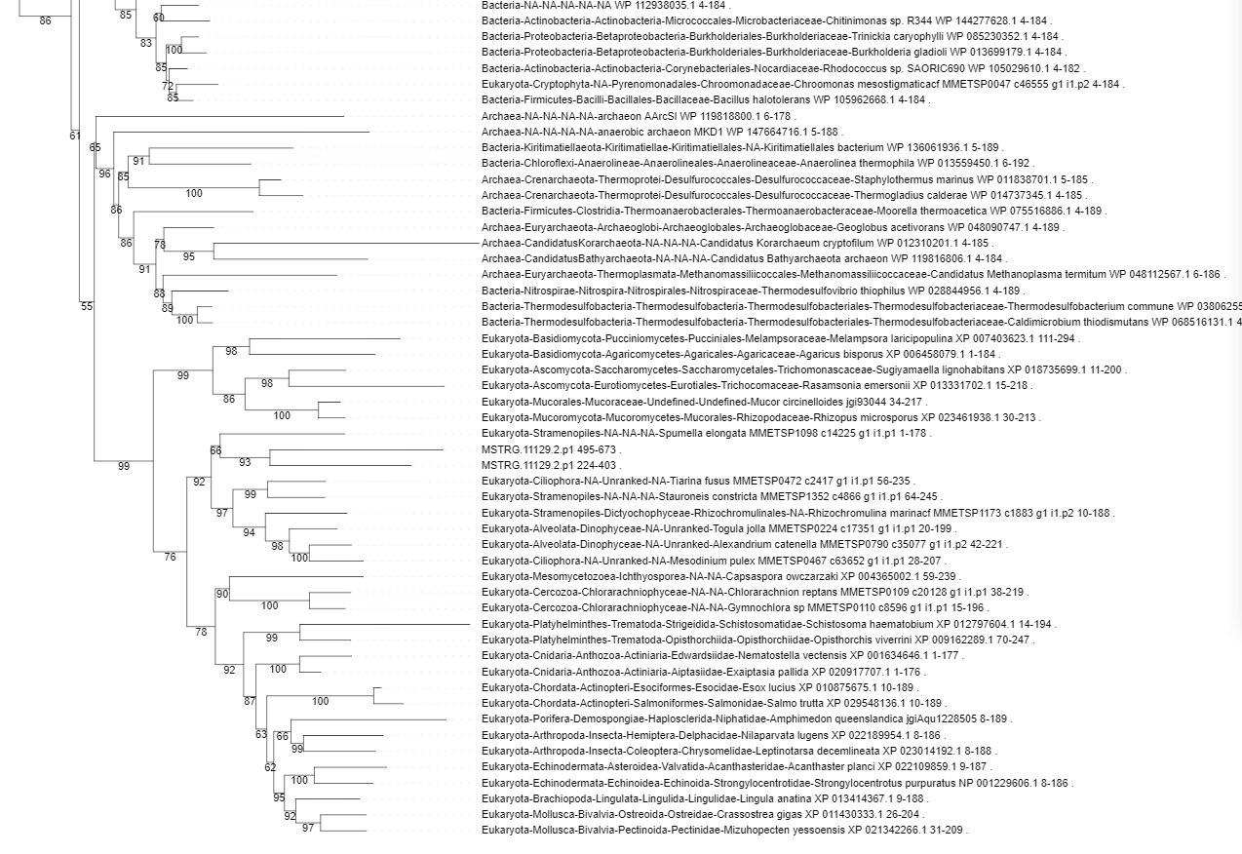

Slide 46
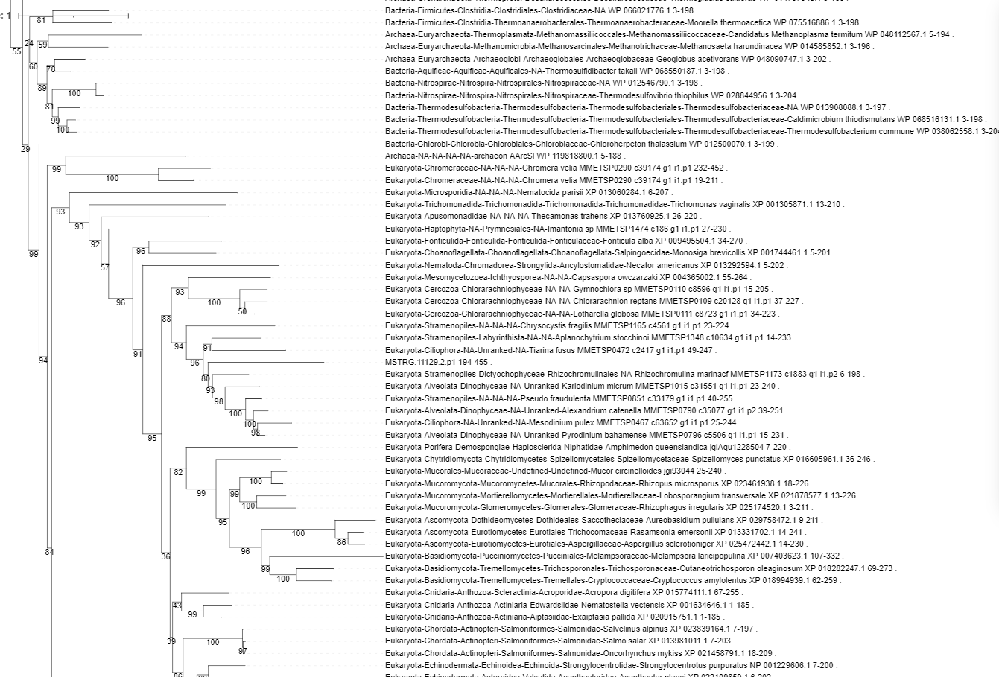

Slide 47
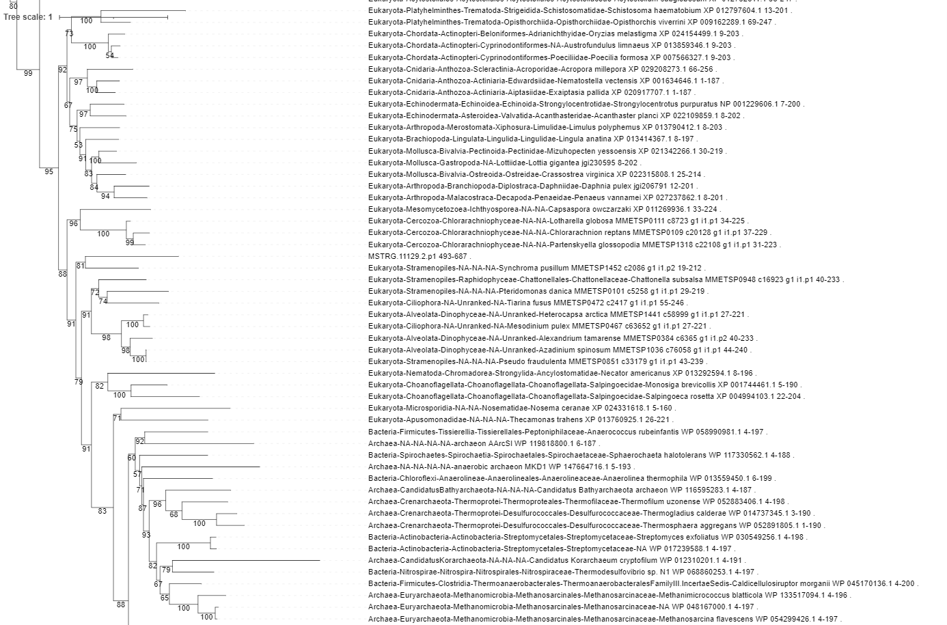

Slide 48
MSTRG.17384.1

Slide 49
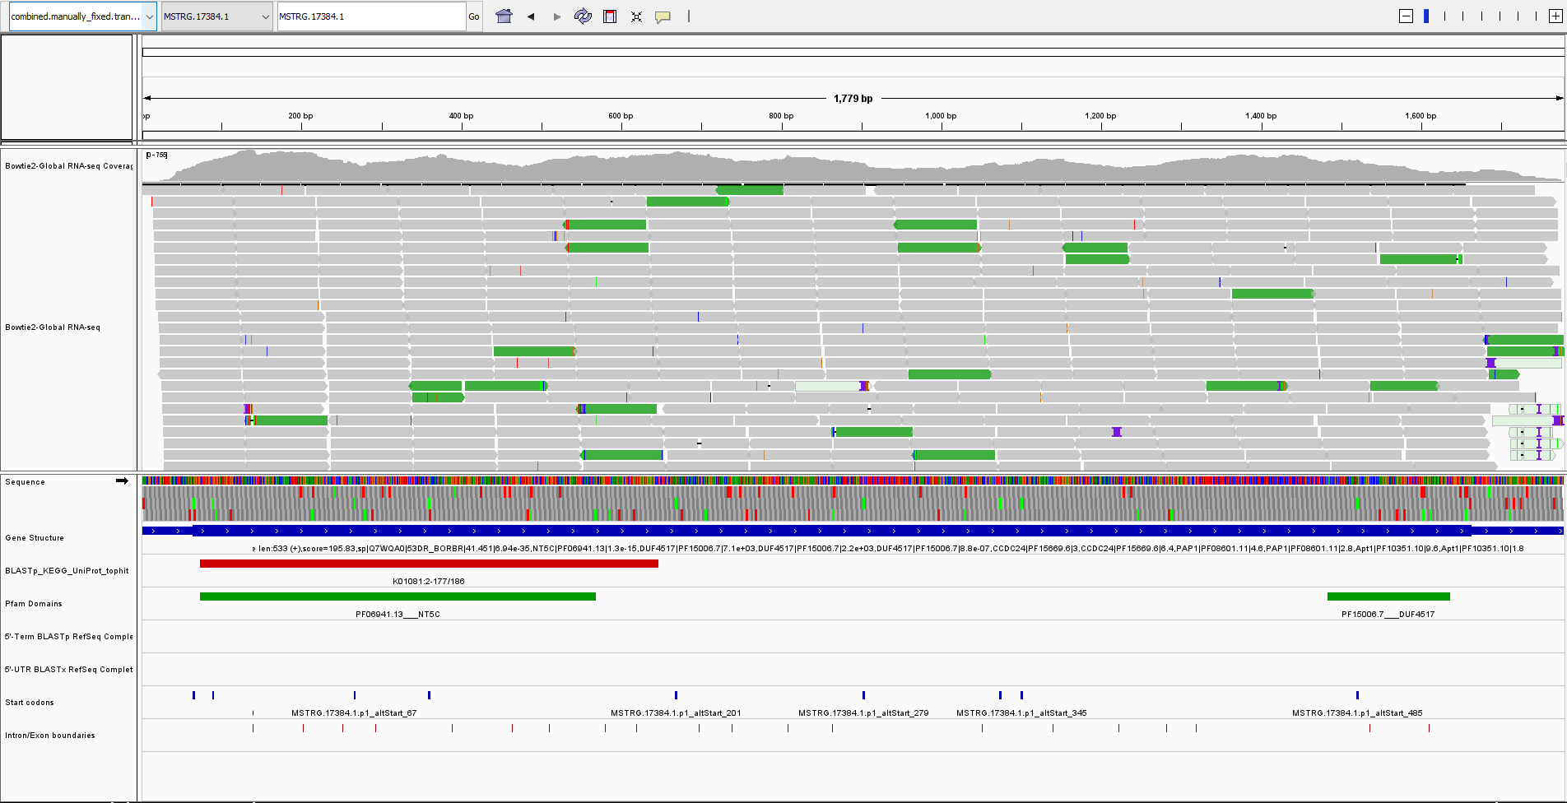

Slide 50
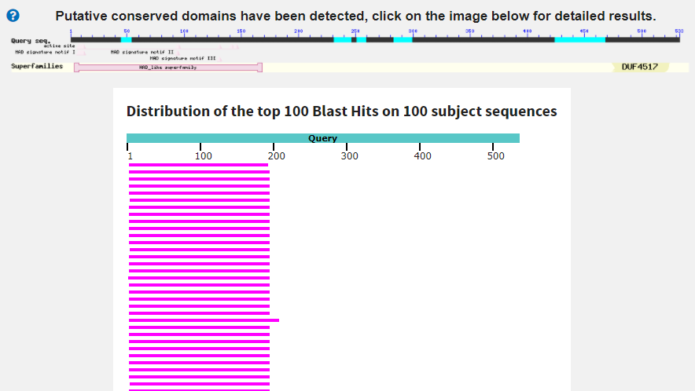
5'-3'-deoxyribonucleotidase [Candidatus Harrisonbacteri..
Score:139 Evalue:1.9e-34
Accession:MBI2024757.1
Doesn’t appear to be any hits covering the DUF4517 domain

Slide 51
NT5C (PF06941)
5' nucleotidase, deoxy (Pyrimidine), cytosolic type C protein (NT5C)
DUF4517 (PF15006)
Domain of unknown function (DUF4517)
Two domains have not been described together previously.
Phylogenetic origin of base/expected domains?
Phylogenetic origin of extra domains?

Slide 52
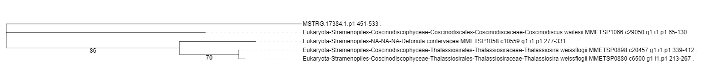
MSTRG.17384.1.p1 3 194 MSTRG.17384.1.p1_KEGGhit
- Eukaryotic origin.
MSTRG.17384.1.p1 450 533 MSTRG.17384.1.p1_DIF4517
- Only 5 taxa in tree. Eukaryotic origin.

Slide 53
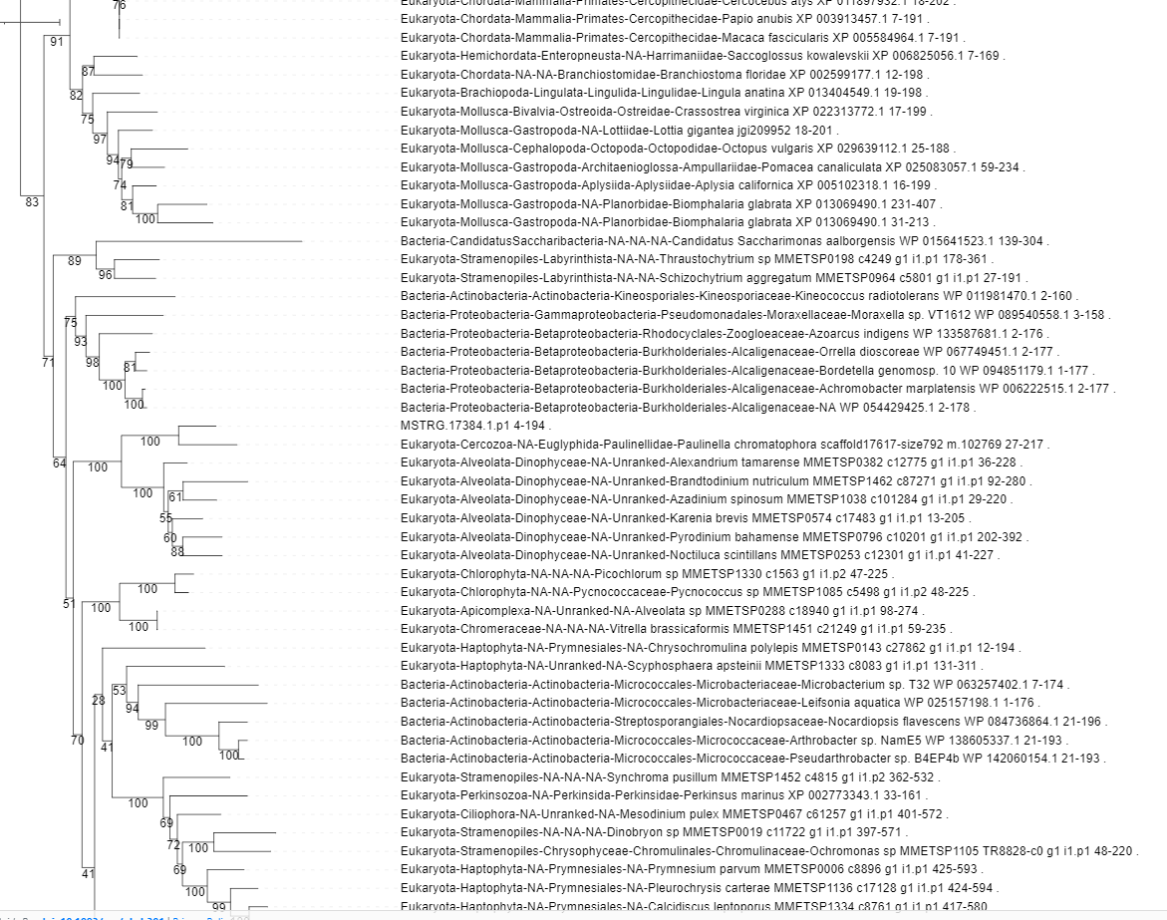

Slide 54
MSTRG.312.1

Slide 55
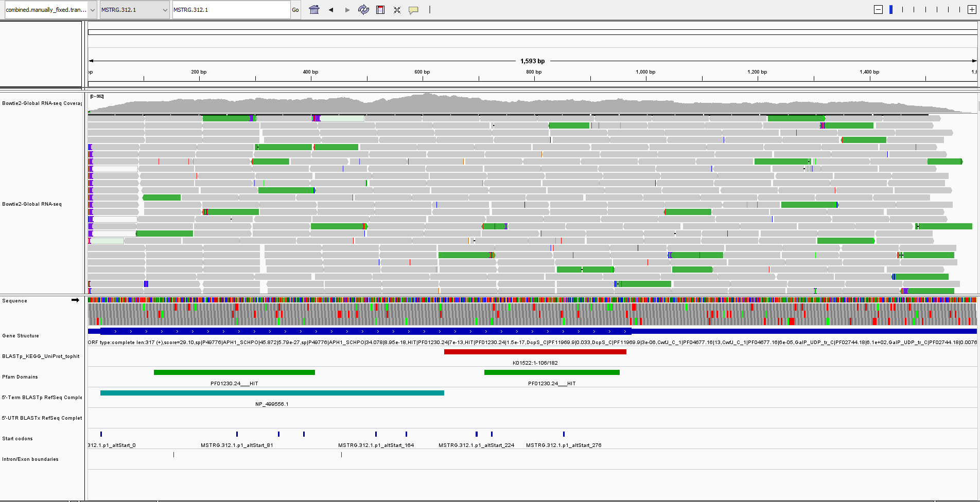

Slide 56
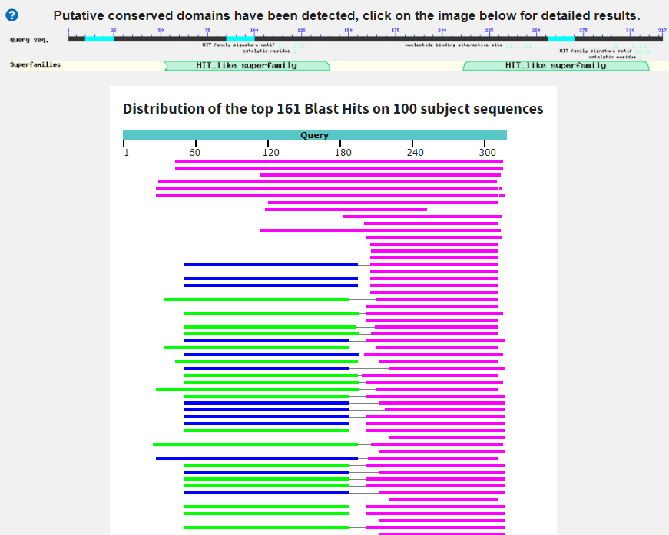
unnamed protein product [Polarella glacialis]
Score:171 Evalue:5.2e-47
Accession:CAE8584683.1
Eukaryota; Sar; Alveolata; Dinophyceae; Suessiales; Suessiaceae; Polarella.
Top 4 hits are from Dino’s. Not sure why.

Slide 57
HIT (PF01230)
HIT domain
Two HIT domains are also often found together – Not surprising that we also see this I guess
Two of these domains on the same sequence are not surprising (possibly even expected)
Phylogenetic origin of base/expected domains?
Phylogenetic origin of extra domains?

Slide 58
MSTRG.312.1.p1 0 205 MSTRG.312.1.p1_BLASTX
- Eukaryotic origin but close to bacterial sequences.
MSTRG.312.1.p1 205 314 MSTRG.312.1.p1_KEGGhit
- Eukaryotic origin.
MSTRG.312.1.p1 32 128 MSTRG.312.1.p1_HIT
- Eukaryotic origin.
MSTRG.312.1.p1 229 310 MSTRG.312.1.p1_HIT
- Eukaryotic origin.
Two HIT domains are in different parts of the tree but are separated by weakly supported nodes, so cant say for sure if they have different origins/history.

Slide 59
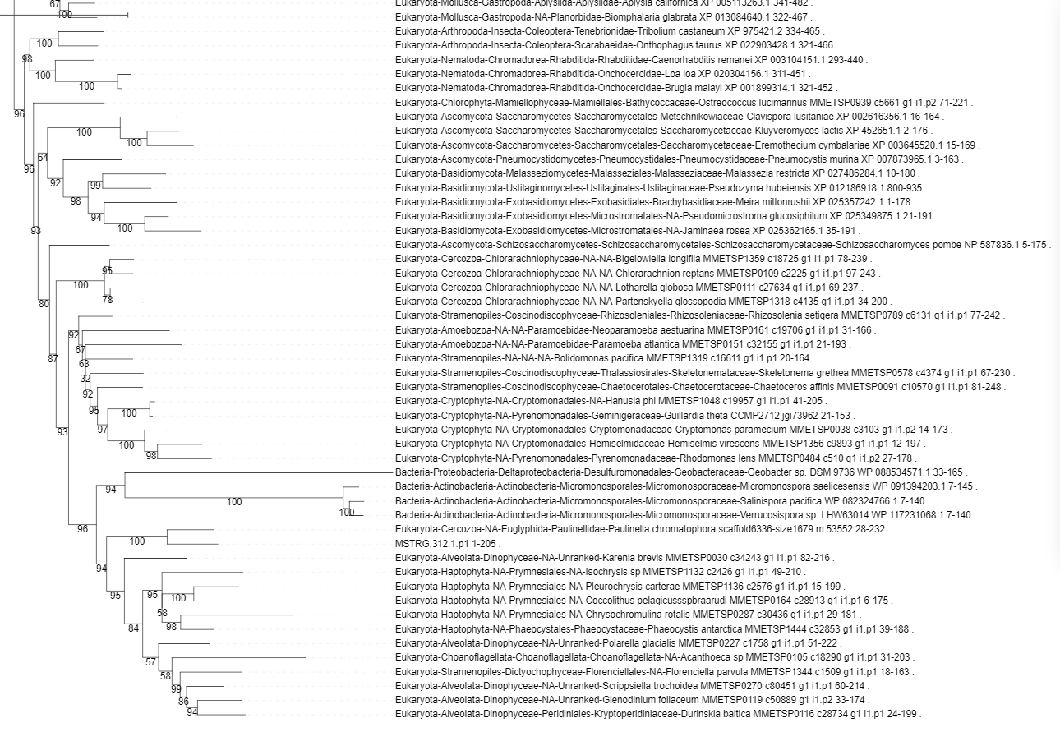

Slide 60
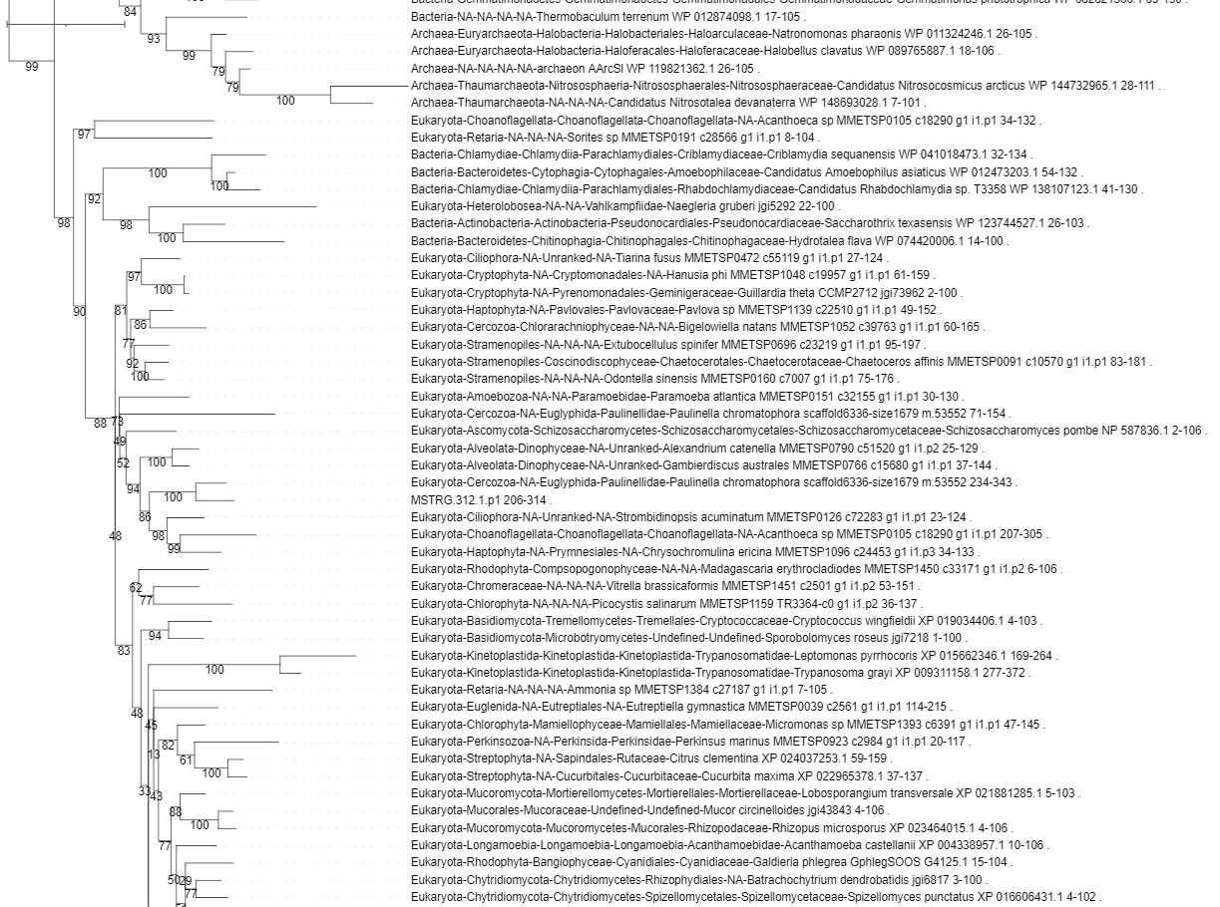

Slide 61
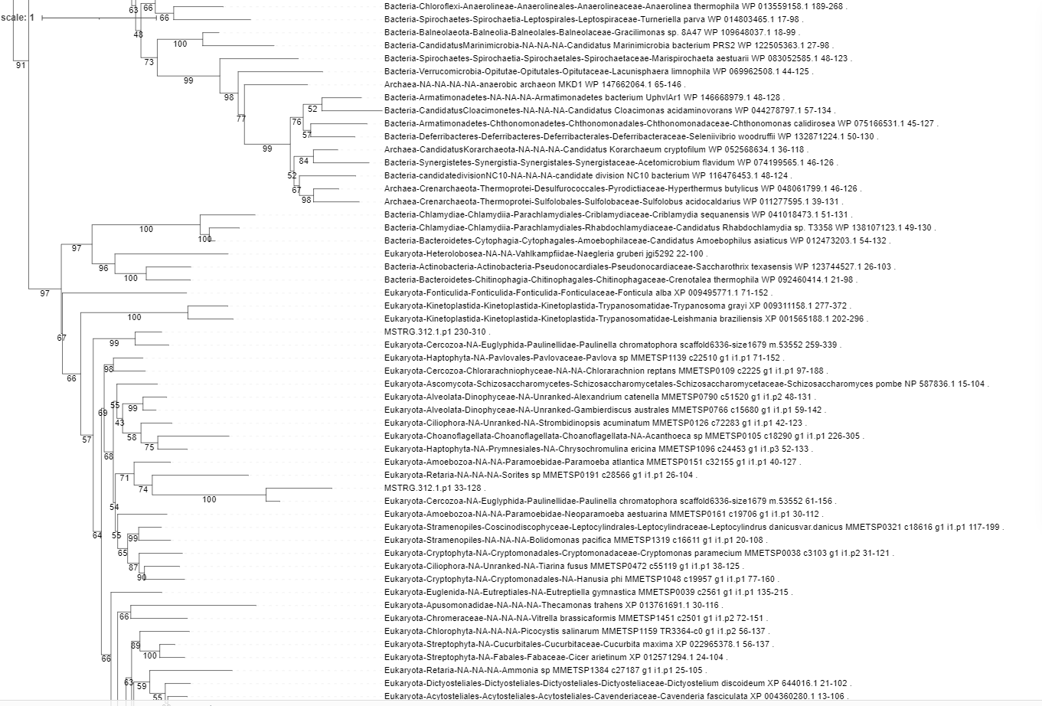

Slide 62
MSTRG.6905.1

Slide 63
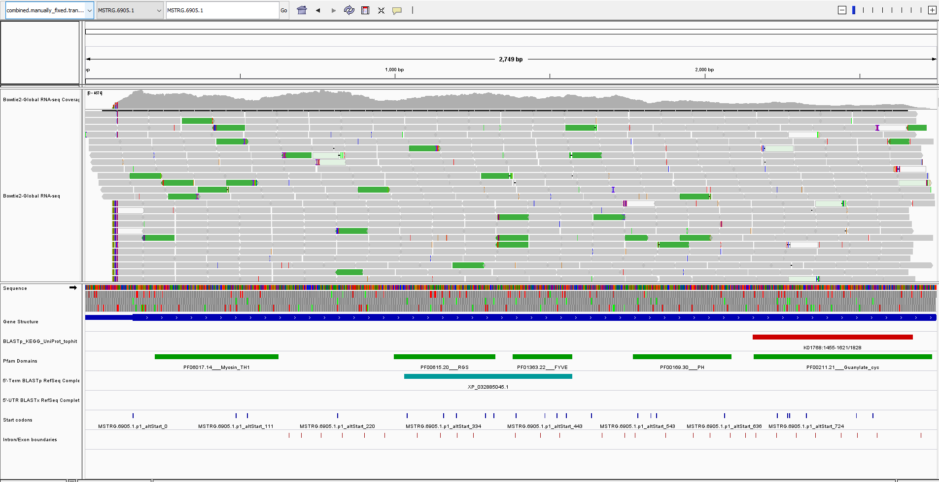

Slide 64
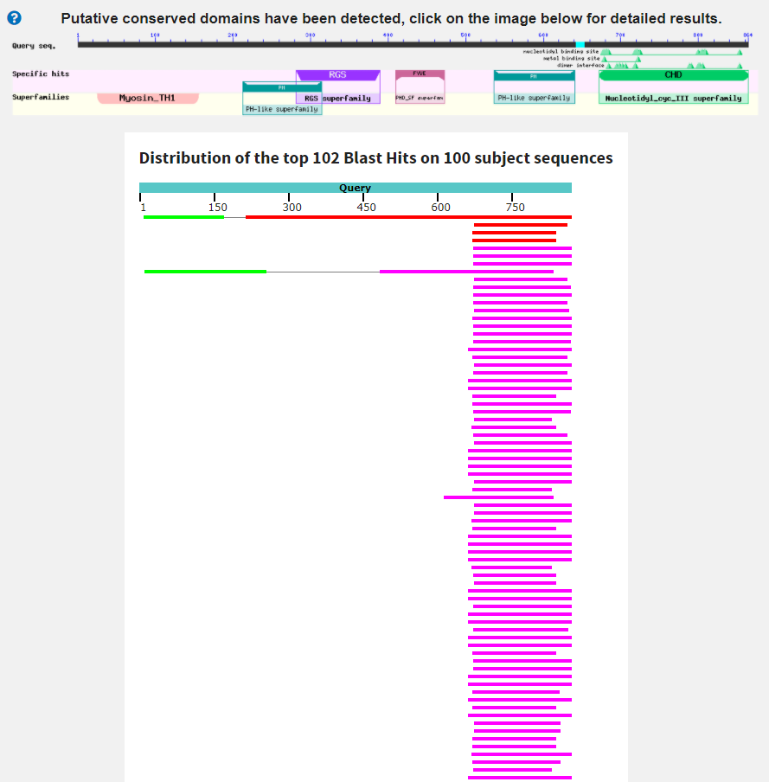
unnamed protein product [Plasmodiophora brassicae]
Score:77 Evalue:2.2e-10
Accession:SPR00522.1
Only 35% ID. Only seq in DB that covers most of query.

Slide 65
Myosin_TH1 (PF06017)
Unconventional myosin tail, actin- and lipid-binding
RGS (PF00615)
Regulator of G protein signaling domain
FYVE (PF01363)
FYVE zinc finger
PH (PF00169)
PH domain
Guanylate_cyc (PF00211)
Adenylate and Guanylate cyclase catalytic domain
This combination of domains has not been described in other species.
Phylogenetic origin of base/expected domains?
Phylogenetic origin of extra domains?
How KEGG hit coverage. Possibly not the actual protein we are interested in.

Slide 66
MSTRG.6905.1.p1 292 473 MSTRG.6905.1.p1_BLASTX
- Eukaryotic origin.
MSTRG.6905.1.p1 667 839 MSTRG.6905.1.p1_KEGGhit
- Eukaryotic origin. Tree overall, is full of weakly supported nodes.
MSTRG.6905.1.p1 24 157 MSTRG.6905.1.p1_Myosin_TH1
- Eukaryotic origin.
MSTRG.6905.1.p1 538 644 MSTRG.6905.1.p1_PH
- Eukaryotic domains. Seems very specific to Cercozoa.

Slide 67
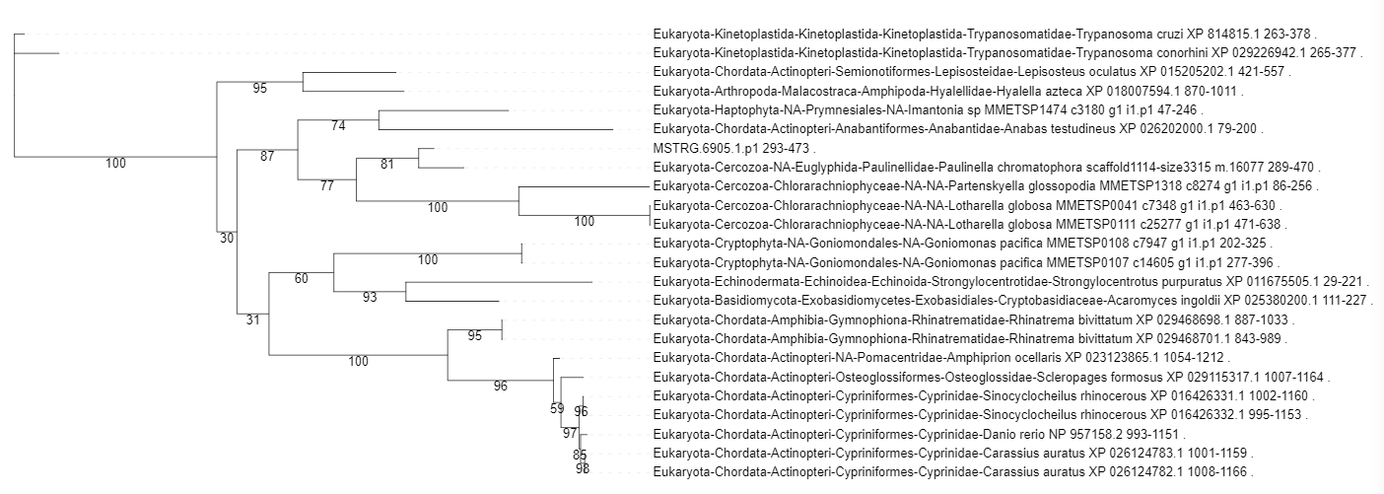

Slide 68
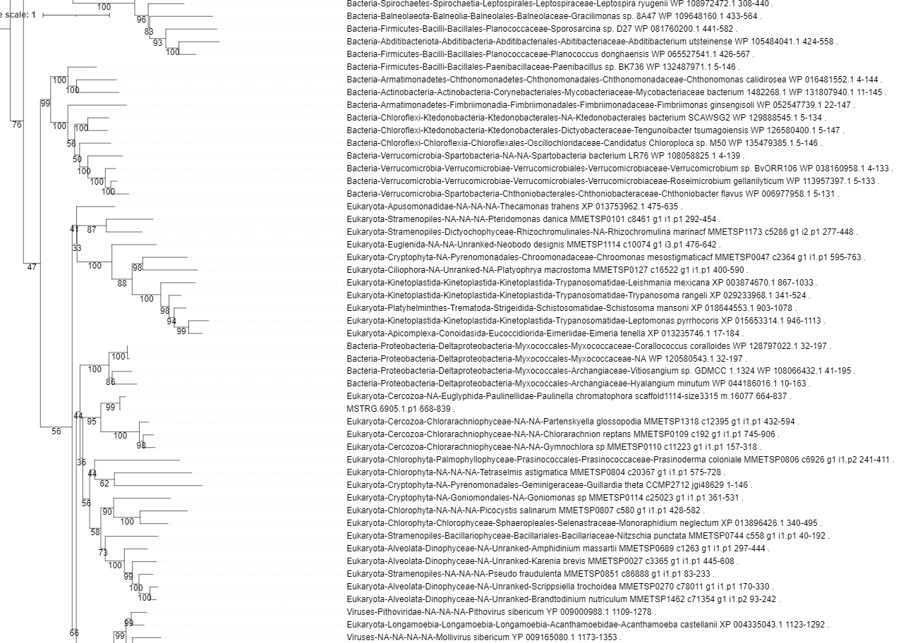

Slide 69
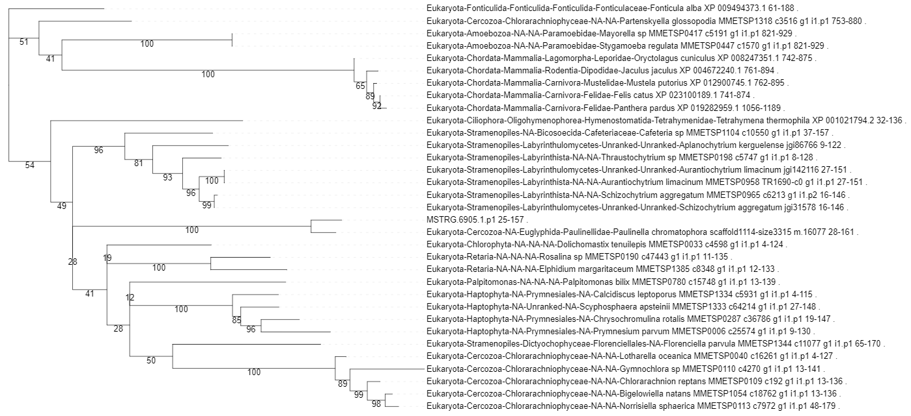

Slide 70
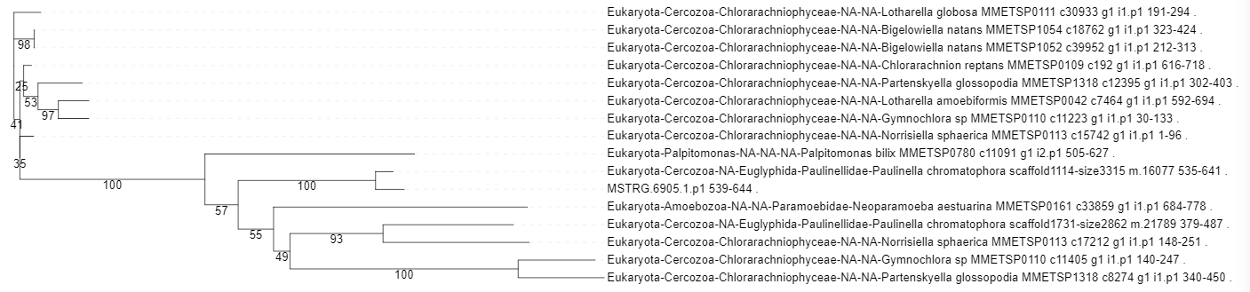

Slide 71
MSTRG.17428.2

Slide 72
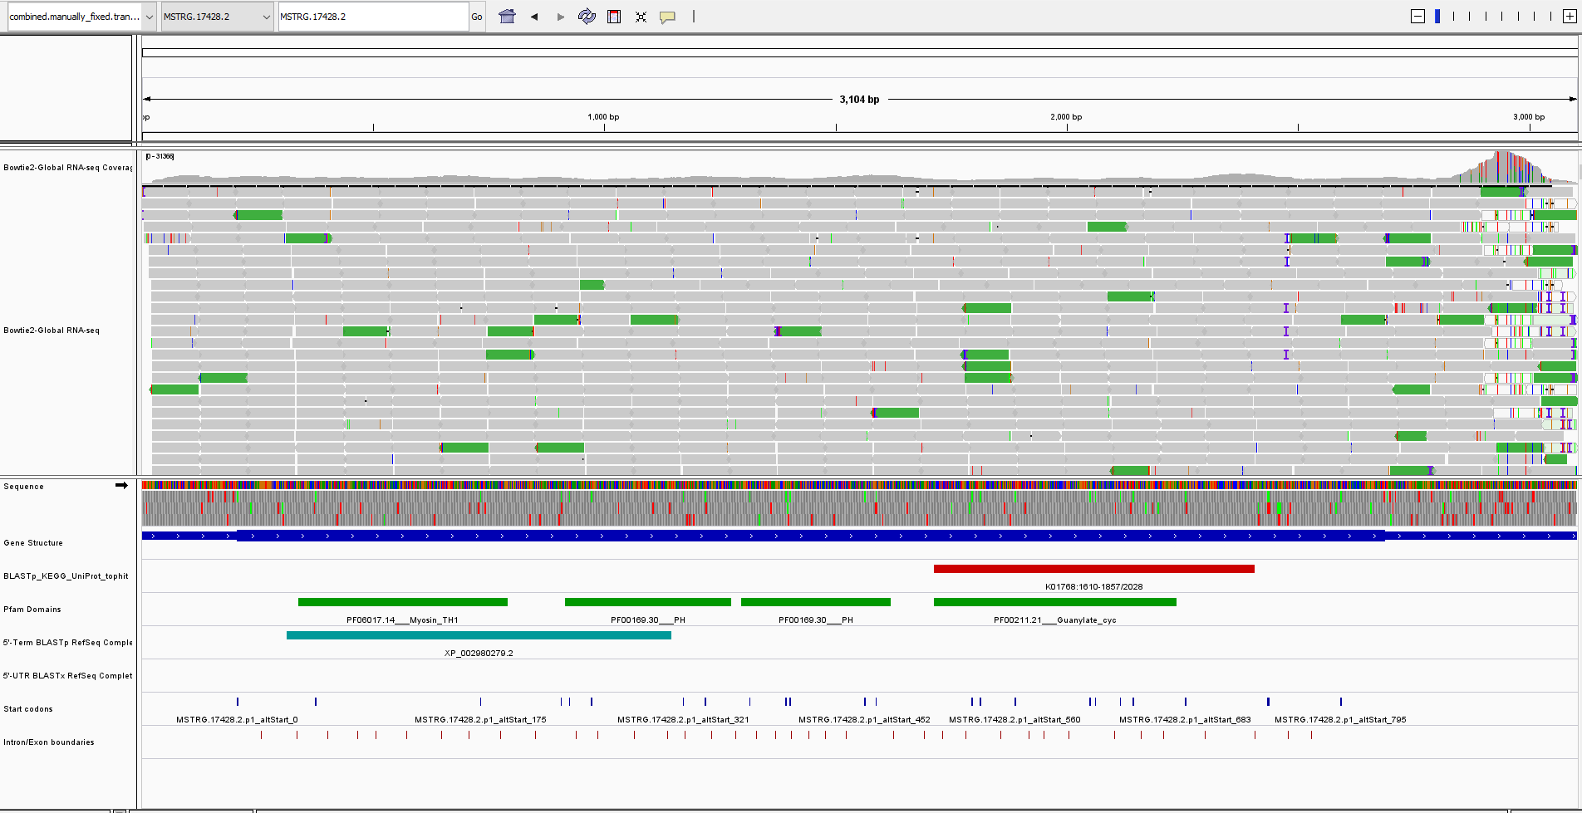

Slide 73
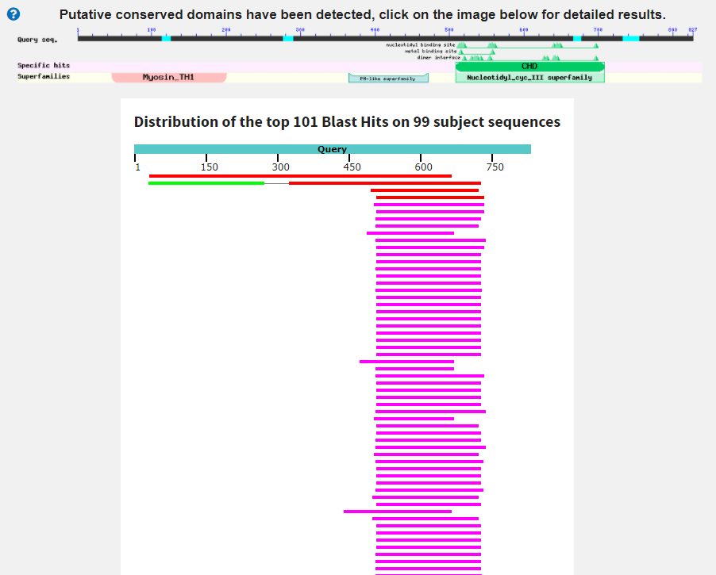
unnamed protein product [Plasmodiophora brassicae]
Score:273 Evalue:2.2e-76
Accession:SPQ98415.1
Only 30% ID.

Slide 74
Myosin_TH1 (PF06017)
Unconventional myosin tail, actin- and lipid-binding
PH (PF00169)
PH domain
Guanylate_cyc (PF00211)
Adenylate and Guanylate cyclase catalytic domain
This combination of domains has not been described in other species.
Phylogenetic origin of base/expected domains?
Phylogenetic origin of extra domains?
How KEGG hit coverage. Possibly not the actual protein we are interested in.

Slide 75
MSTRG.17428.2.p1 36 313 MSTRG.17428.2.p1_BLASTX
- Eukaryotic origin. Seems very specific to Cercozoa.
MSTRG.17428.2.p1 502 733 MSTRG.17428.2.p1_KEGGhit
- Eukaryotic origin. Lost of the deep nodes have weak support.
MSTRG.17428.2.p1 236 356 MSTRG.17428.2.p1_PH
- Eukaryotic origin. Seems very specific to Cercozoa.
MSTRG.17428.2.p1 363 471 MSTRG.17428.2.p1_PH
- Eukaryotic origin. Seems very specific to Cercozoa.

Slide 76
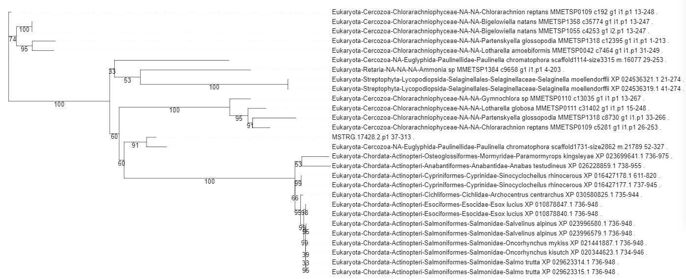

Slide 77


Slide 78


Slide 79
MSTRG.8769.3

Slide 80


Slide 81

unnamed protein product [Plasmodiophora brassicae]
Score:273 Evalue:8.5e-79
Accession:SPR00522.1
44% ID

Slide 82
PH (PF00169)
PH domain
Guanylate_cyc (PF00211)
Adenylate and Guanylate cyclase catalytic domain
Phylogenetic origin of base/expected domains?
Phylogenetic origin of extra domains?
How KEGG hit coverage. Possibly not the actual protein we are interested in.

Slide 83
MSTRG.8769.3.p1 1 101 MSTRG.8769.3.p1_PH
- Eukaryotic origin. Seems very specific to Cercozoa.
MSTRG.8769.3.p1 125 345 MSTRG.8769.3.p1_KEGGhit
- Eukaryotic origin. Weak internal nodes.

Slide 84


Slide 85


Slide 86
MSTRG.25154.2

Slide 87


Slide 88


Slide 89

hypothetical protein SDRG_09110 [Saprolegnia diclina VS..
Score:229 Evalue:1.2e-64
Accession:XP_008613245.1
38% ID

Slide 90
GAF (PF01590)
GAF domain
Phylogenetic origin of base/expected domains?
Phylogenetic origin of extra domains?
How KEGG hit coverage. Possibly not the actual protein we are interested in.

Slide 91
xxx

Slide 93
MSTRG.7895.1

Slide 94


Slide 95

hypothetical protein Poli38472_004098 [Pythium oligandr..
Score:496 Evalue:5.4e-159
Accession:TMW66333.1
42% ID
Eukaryota; Stramenopiles; Oomycetes; Pythiales; Pythiaceae; Pythium.

Slide 96
DEAD (PF00270)
DEAD/DEAH box helicase
Helicase_C (PF00271)
Helicase conserved C-terminal domain
DBP10CT (PF08147)
DBP10CT (NUC160) domain
All three domains are found together in other species in the same order (this is the most common configuration actually).
Domain configuration has been previously observed. Might be expected
Phylogenetic origin of base/expected domains?
Phylogenetic origin of extra domains?
How KEGG hit coverage. Possibly not the actual protein we are interested in.

Slide 97
MSTRG.7895.1.p1 0 590 MSTRG.7895.1.p1_BLASTX
- Eukaryotic origin. Weak internal nodes.
MSTRG.7895.1.p1 592 687 MSTRG.7895.1.p1_KEGGhit
- Only 2 seqs passed filtering and were available for building a tree.
MSTRG.7895.1.p1 592 734 MSTRG.7895.1.p1_Combined
- Eukaryotic origin. Limited to Cercozoa and Streptophyta.

Slide 98


Slide 99


Slide 100
MSTRG.831.1

Slide 101


Slide 102


Slide 103
5_nucleotid_C (PF02872)
5'-nucleotidase, C-terminal domain
ANF_receptor (PF01094)
Receptor family ligand binding region
7tm_3 (PF00003)
7 transmembrane sweet-taste receptor of 3 GCPR
Pkinase (PF00069)
Protein kinase domain
Many of these domains are associated with each other but this specific combination and order has not been observed before.
Phylogenetic origin of base/expected domains?
Phylogenetic origin of extra domains?

Slide 104
MSTRG.831.1.p1 183 738 MSTRG.831.1.p1_KEGGhit
- Eukaryotic origin.
MSTRG.831.1.p1 768 938 MSTRG.831.1.p1_ANF_receptor
- Eukaryotic origin. Limited distribution in other eukaryotes.
MSTRG.831.1.p1 1006 1192 MSTRG.831.1.p1_ANF_receptor
- Eukaryotic origin. Limited distribution in other eukaryotes.
MSTRG.831.1.p1 1383 1627 MSTRG.831.1.p1_7tm_3
- Eukaryotic origin. Weak internal nodes but tree only has eukaryotes in it.
MSTRG.831.1.p1 2358 2716 MSTRG.831.1.p1_Pkinase
- Eukaryotic origin.

Slide 105


Slide 106


Slide 107


Slide 108


Slide 109
MSTRG.19222.1

Slide 110


Slide 111

5'-nucleotidase C-terminal domain-containing protein [C..
Score:191 Evalue:1.6e-47
Accession:NWF70848.1
30% ID

Slide 112
5_nucleotid_C (PF02872)
5'-nucleotidase, C-terminal domain
ANF_receptor (PF01094)
Receptor family ligand binding region
RGS (PF00615)
Regulator of G protein signaling domain
Domains in this configuration have not been previously described
Phylogenetic origin of base/expected domains?
Phylogenetic origin of extra domains?

Slide 113
MSTRG.19222.1.p1 60 601 MSTRG.19222.1.p1_KEGGhit
- Eukaryotic origin. Weak internal nodes but no reason to suggest that its not eukaryotic.
MSTRG.19222.1.p1 637 970 MSTRG.19222.1.p1_ANF_receptor
- Eukaryotic origin. Limited distribution in other eukaryotes.
MSTRG.19222.1.p1 1404 1521 MSTRG.19222.1.p1_RGS
- Eukaryotic origin. Very weak nodes in tree but only eukaryotic taxa present so can only be from eukaryotes.

Slide 114


Slide 115


Slide 116


Slide 117
MSTRG.9188.1

Slide 118


Slide 119


Slide 120


Slide 121
GAF (PF01590)
GAF domain
PDEase_I (PF00233)
3'5'-cyclic nucleotide phosphodiesterase
Domain configuration found in a large number of other sequences.
This domain configuration is known – possibly expected to some degree
Phylogenetic origin of base/expected domains?
Phylogenetic origin of extra domains?

Slide 122
MSTRG.9188.1.p1 858 1385 MSTRG.9188.1.p1_BLASTX
- Eukaryotic origin. Cyanobacterial domain?? Plastid origin?
MSTRG.9188.1.p1 1812 2078 MSTRG.9188.1.p1_KEGGhit
- Eukaryotic origin. Only eukaryotes in tree.

Slide 123


Slide 124


